Slide 1
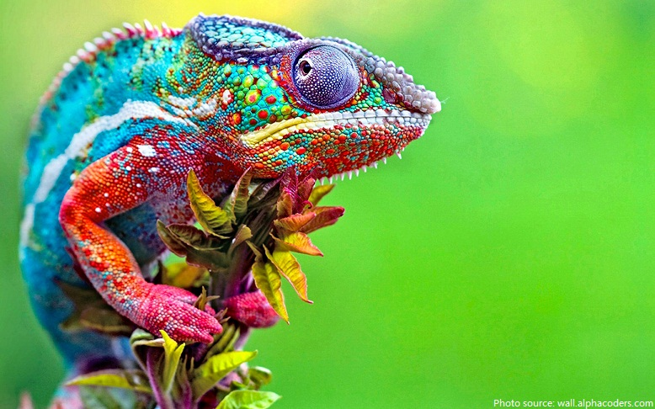
Changes
Relaxing music

Slide 2
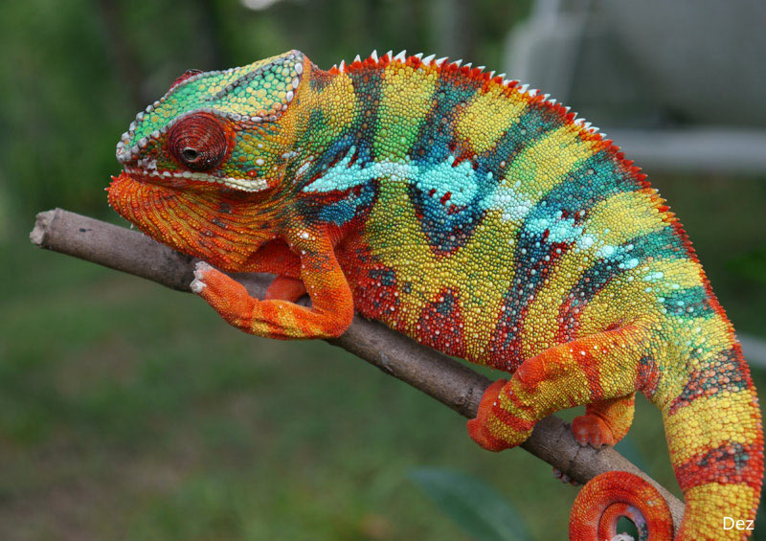
Chameleons
chameleons are a type of lizard
many different varieties
can live in desert and in rainforest
sometimes kept as pets
can change colour to match their environment

Slide 3
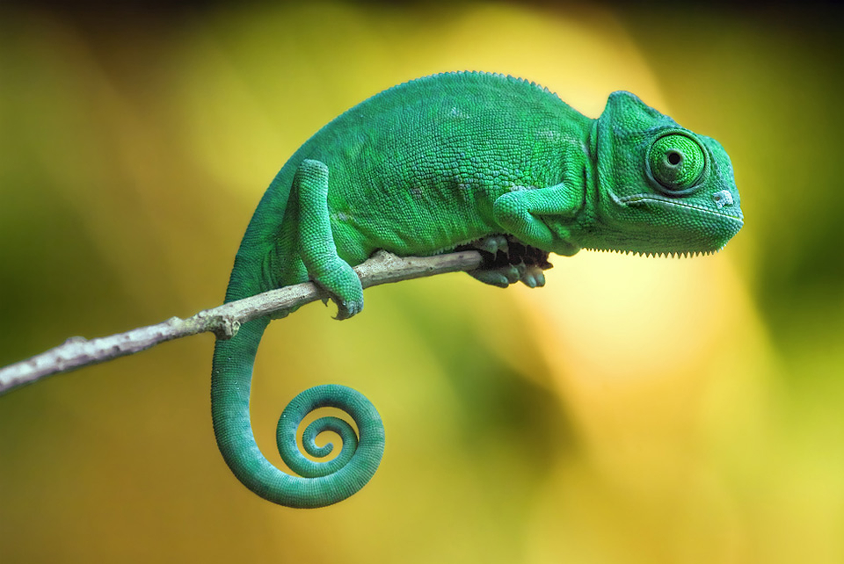
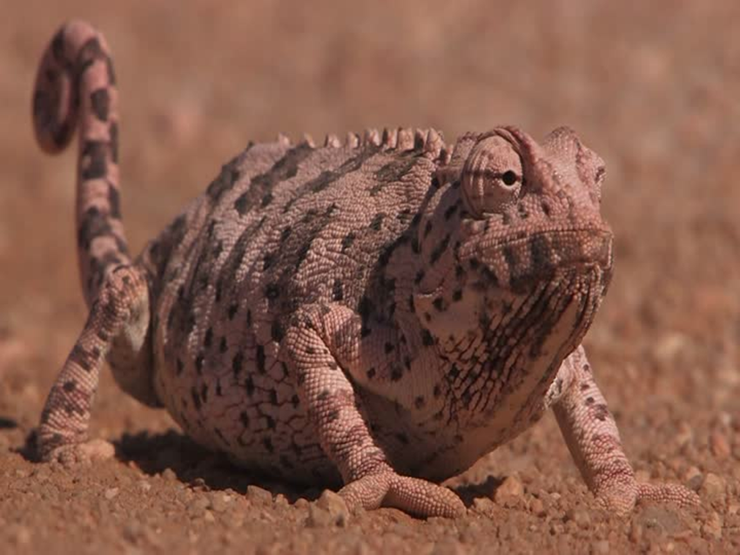
Chameleons
Change their colours according to the environment
Green like leaves of tree
Desert Chameleons change colour to help regulate their body temperature.
light-grey when hot and black when cold
They adapt to changes in their immediate environment.
They do so quickly and efficiently.

Slide 4
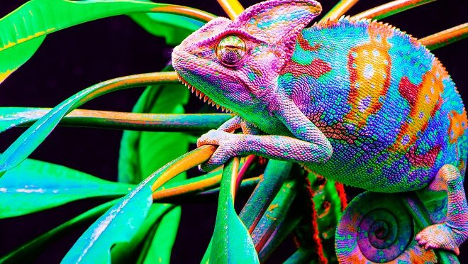
“My God is my rock, in whom I take refuge.“
Psalm 18:2
"Jesus Christ is the same yesterday and today and forever.“
Hebrews 13:8

Slide 5
Dear God,
Please help us with the changes we face in life.
Please help us when we find things difficult.
Please help us to be patient with other people when they are struggling.
Please help us to act with kindness and care.
Amen.

Slide 6

Click on the this link to learn about Chameleons
Beautiful Footage: Chameleons Are Amazing | National Geographic
Song: Be the Change

