Slide 1



Slide 2
Kenya
English and Swahili are Kenya’s two official languages, although each of the country’s 42 ethnic groups has their own dialect
• More than 75% of Kenya’s population lives in rural areas
• Kenya’s average life expectancy is 62 years (UK is 81)

Slide 3
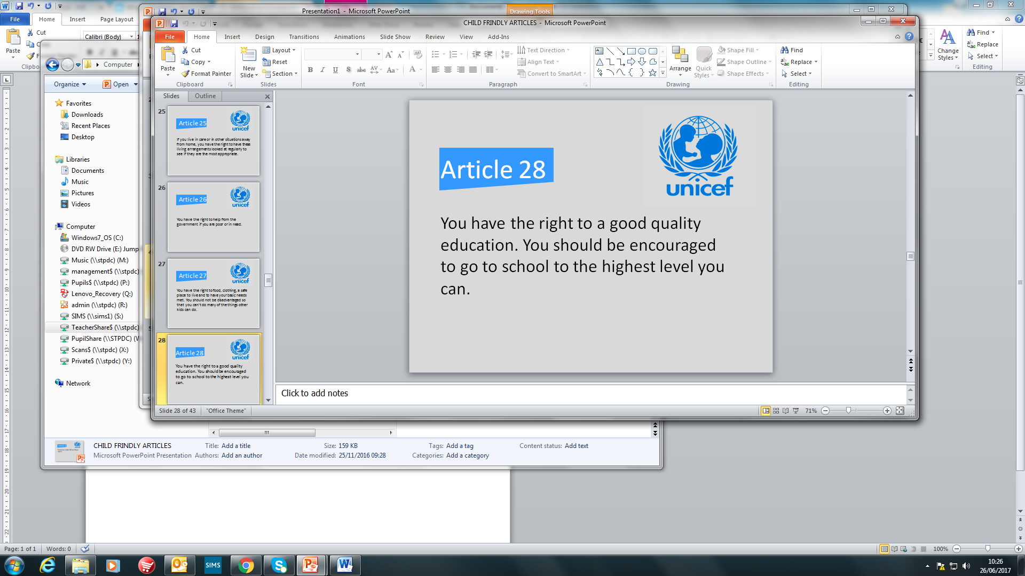
Kenya
• The literacy rate in Kenya is 78% and the average years of schooling is six

Slide 4
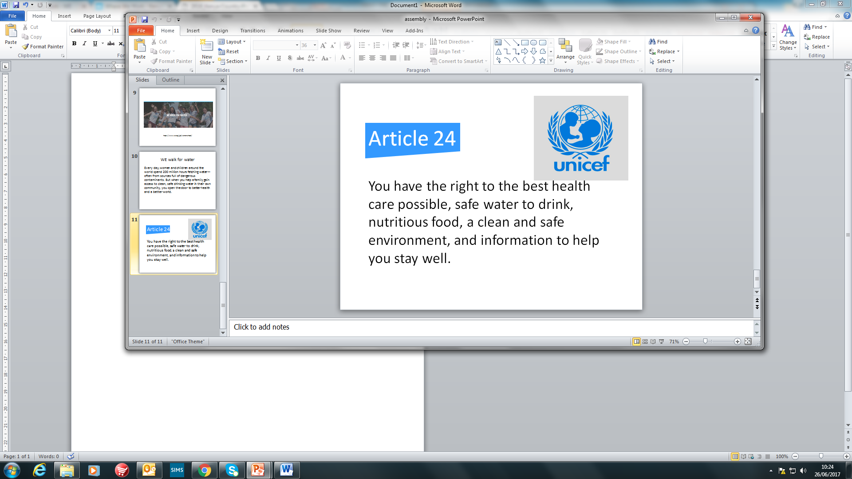
Kenya
Only 54% of those in rural areas have access to improved water sources

Slide 5
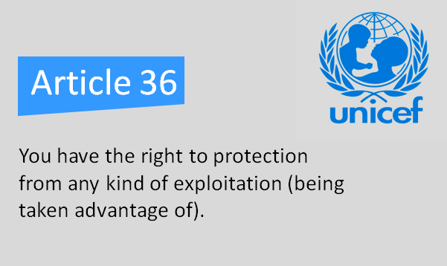
Kenya
• 26% of children aged 5-14 are engaged in child labour

Slide 6
WE walk for water
Much of Kenya is dry.
Water services are poorly distributed and rural Kenya has poor access to clean water .
Two-thirds of the population lack access to adequate sanitation. This leads to 10,000 childhood deaths every year. We help by partnering to provide:
Rain catchment systems
Wells
Hand-washing stations
Latrines
Water and sanitation education

Slide 7
WE walk for water
We help by partnering to provide:
Rain catchment systems
Wells
Hand-washing stations
Latrines
Water and sanitation education

Slide 8
Our plan – ‘Walk for water’ day
Wear blue on Friday 7th July and bring in £1 to donate to helping to improve access to clean water in Kenya.
Water activities all day including a water walk around the playground
Learn the words to a water song to perform at the summer fete to help raise awareness

