Slide 2
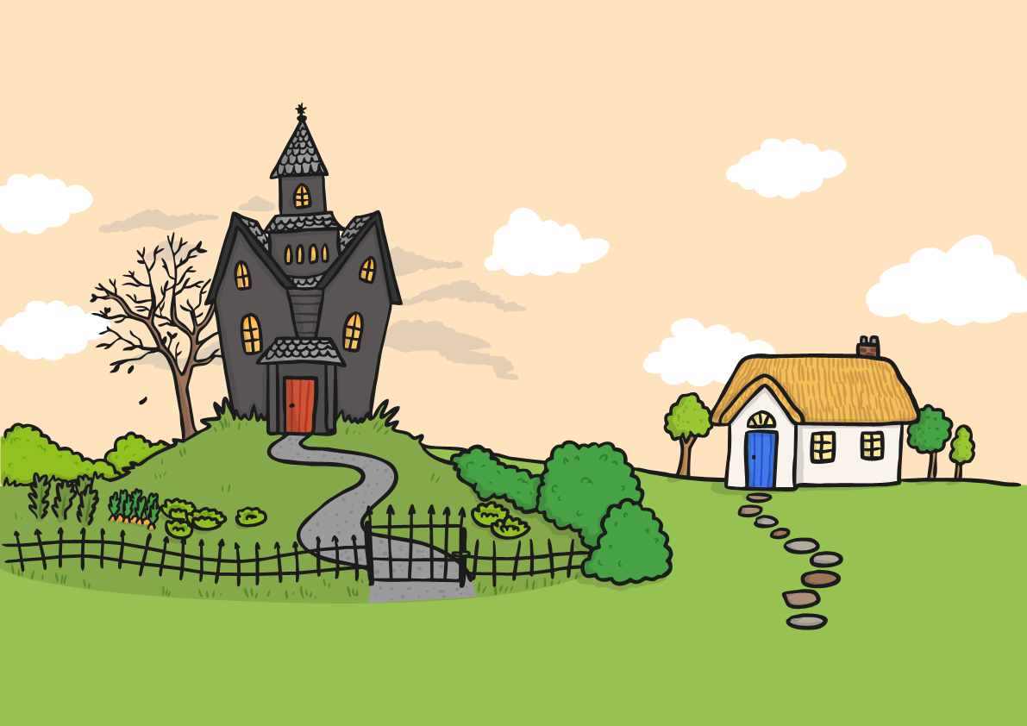
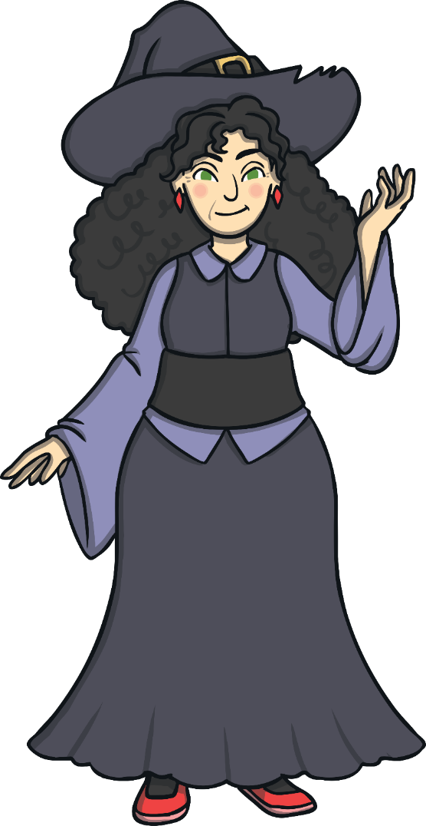
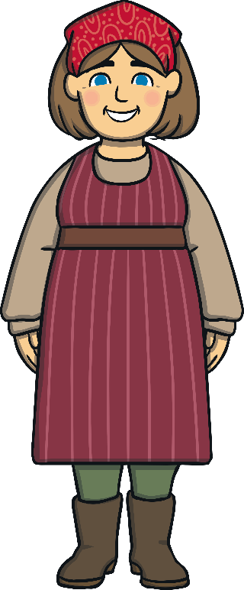
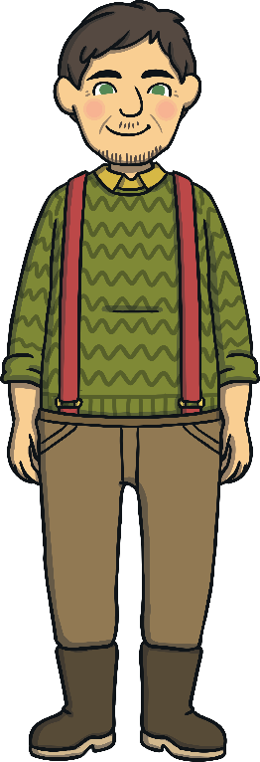
Once upon a time, there lived a man and his wife.
They lived in a house next door to a witch.

Slide 3


The wife longed to eat the lettuces in
the witch’s beautiful garden.

Slide 4

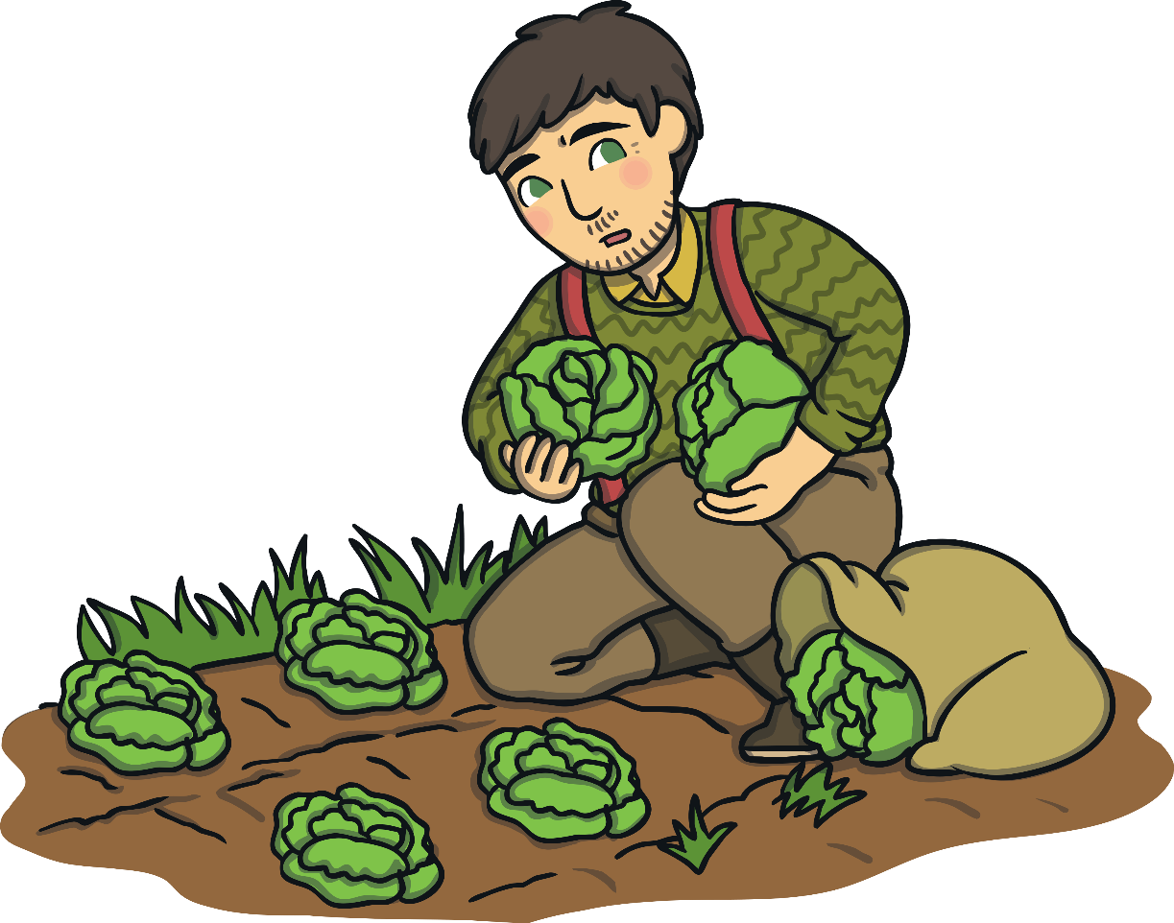
One day, the husband decided to steal some of
the lettuces for his wife. The witch caught him.

Slide 5



The witch told the husband that his wife was soon to have a baby. He must give the baby to the witch in return for the lettuce. The man was so scared that he agreed.

Slide 6


When the little girl was born, the witch took her
away and named her Rapunzel.

Slide 7
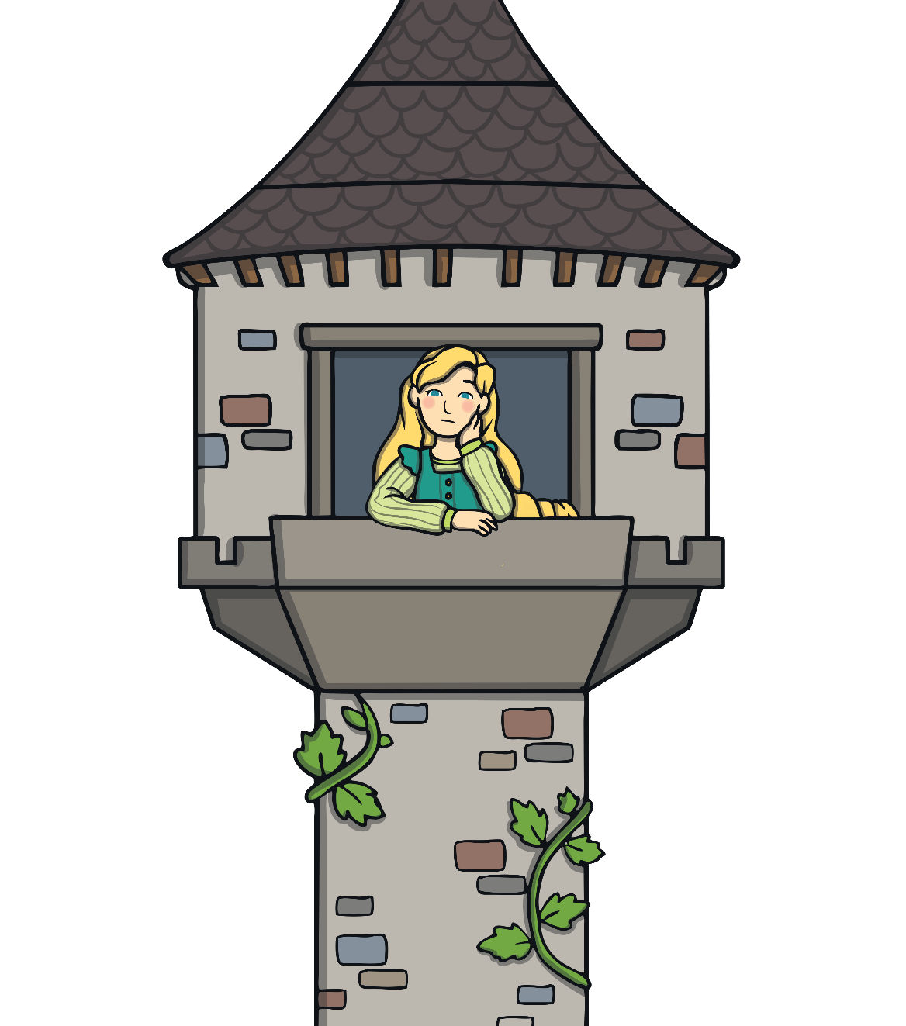
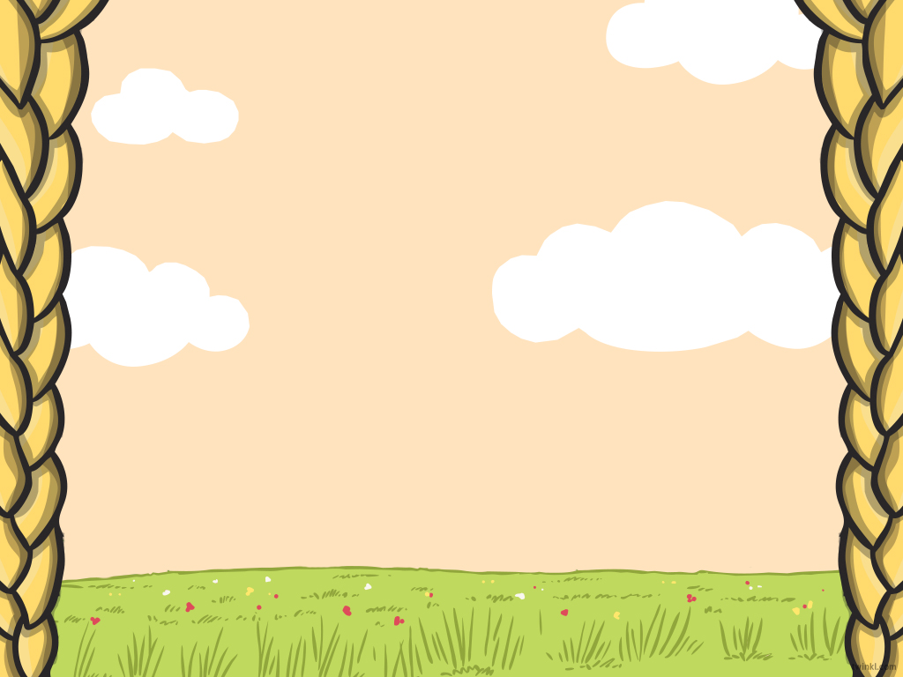
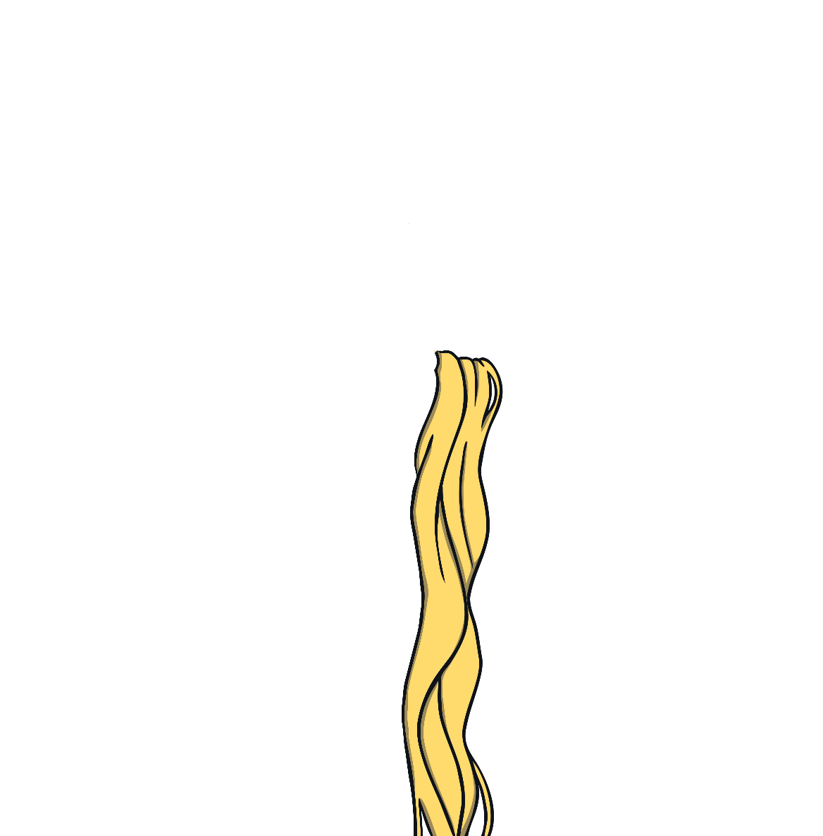
When Rapunzel grew up, the witch locked her away in a tower in the middle of the forest. While Rapunzel lived in the tower, her golden hair grew longer and longer.

Slide 8
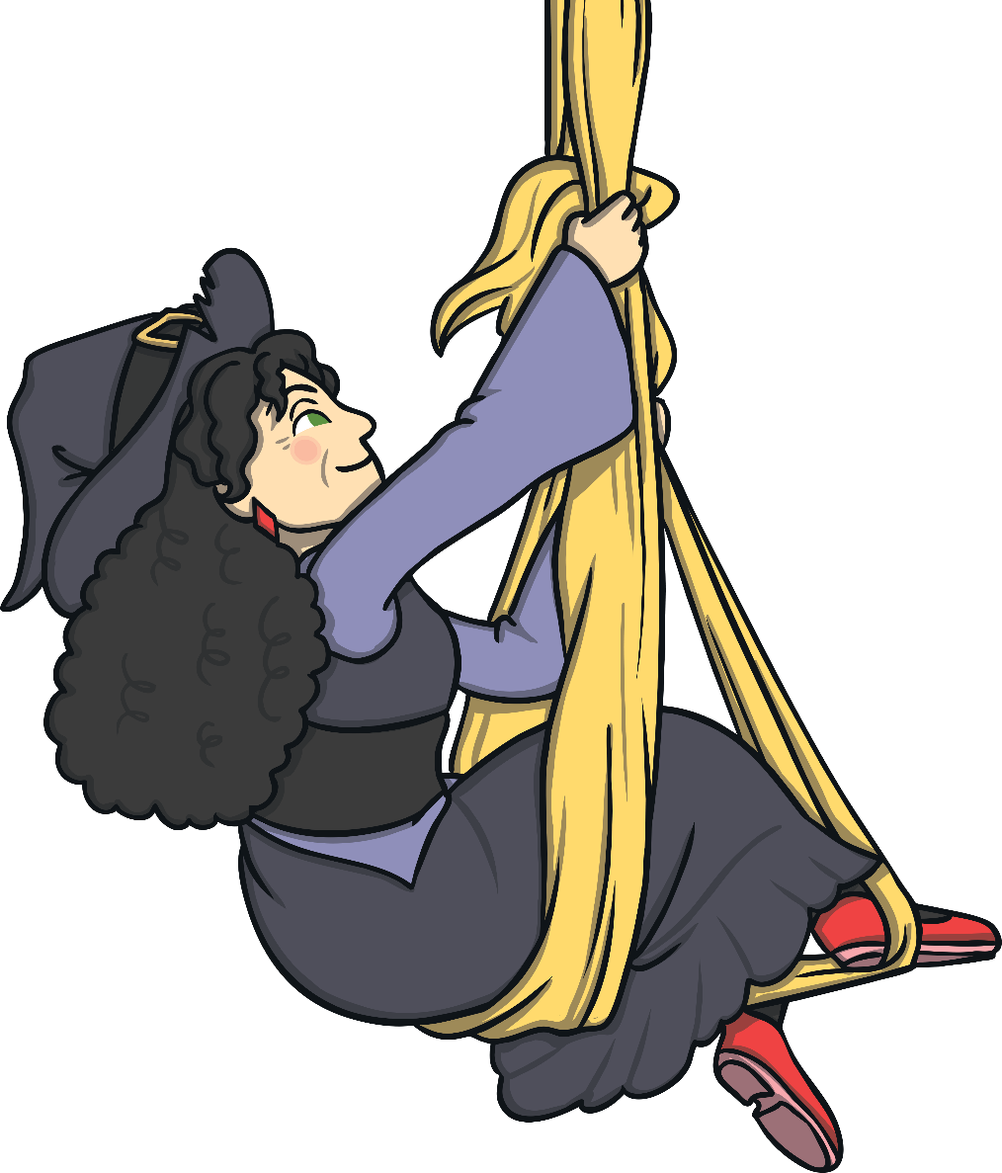
When the witch visited, she would call to Rapunzel to let down her hair, and the witch would climb up.

Slide 9

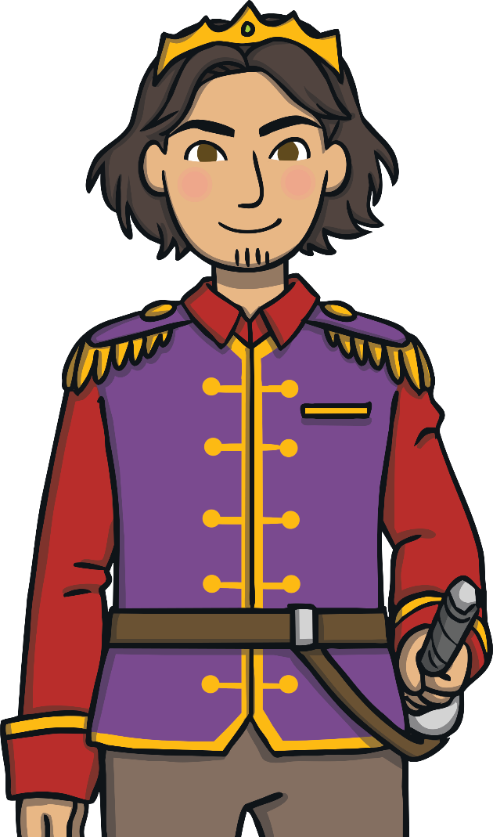
One day, a handsome prince found the tower in
the forest. He watched the witch come to the
tower and climb Rapunzel’s hair.

Slide 10
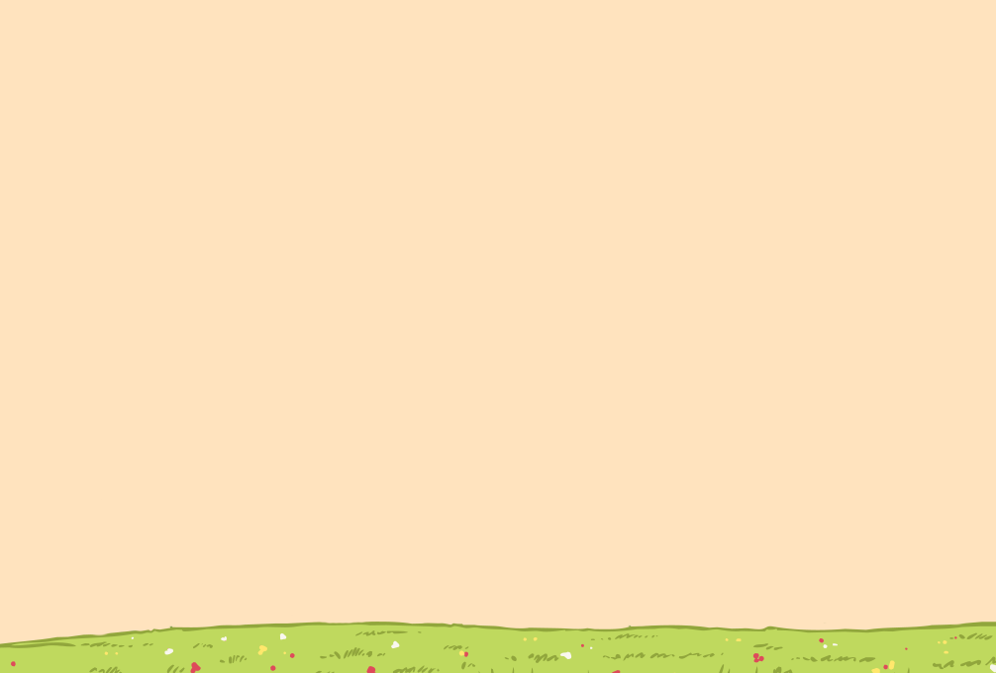

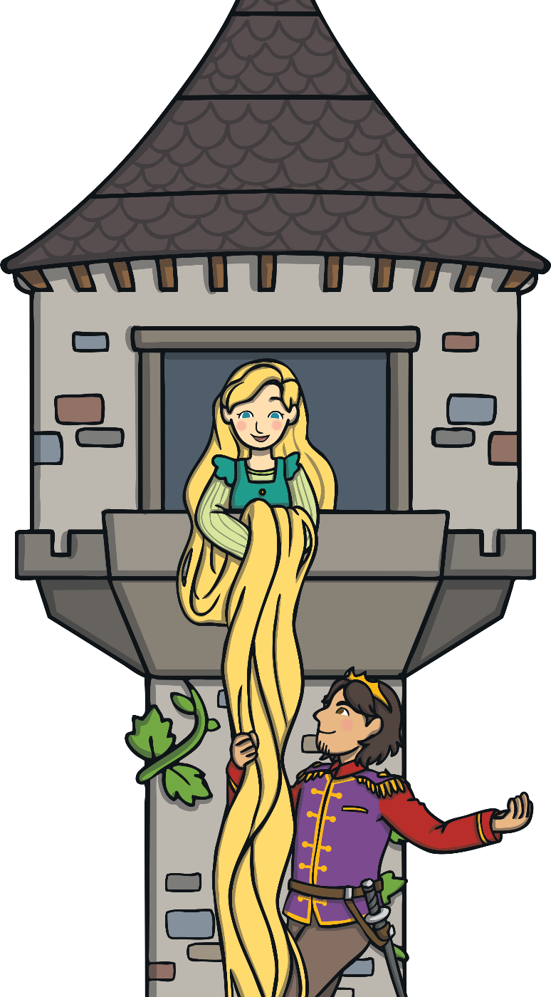


When the witch had gone, the prince climbed
up the tower using Rapunzel’s hair.

Slide 11
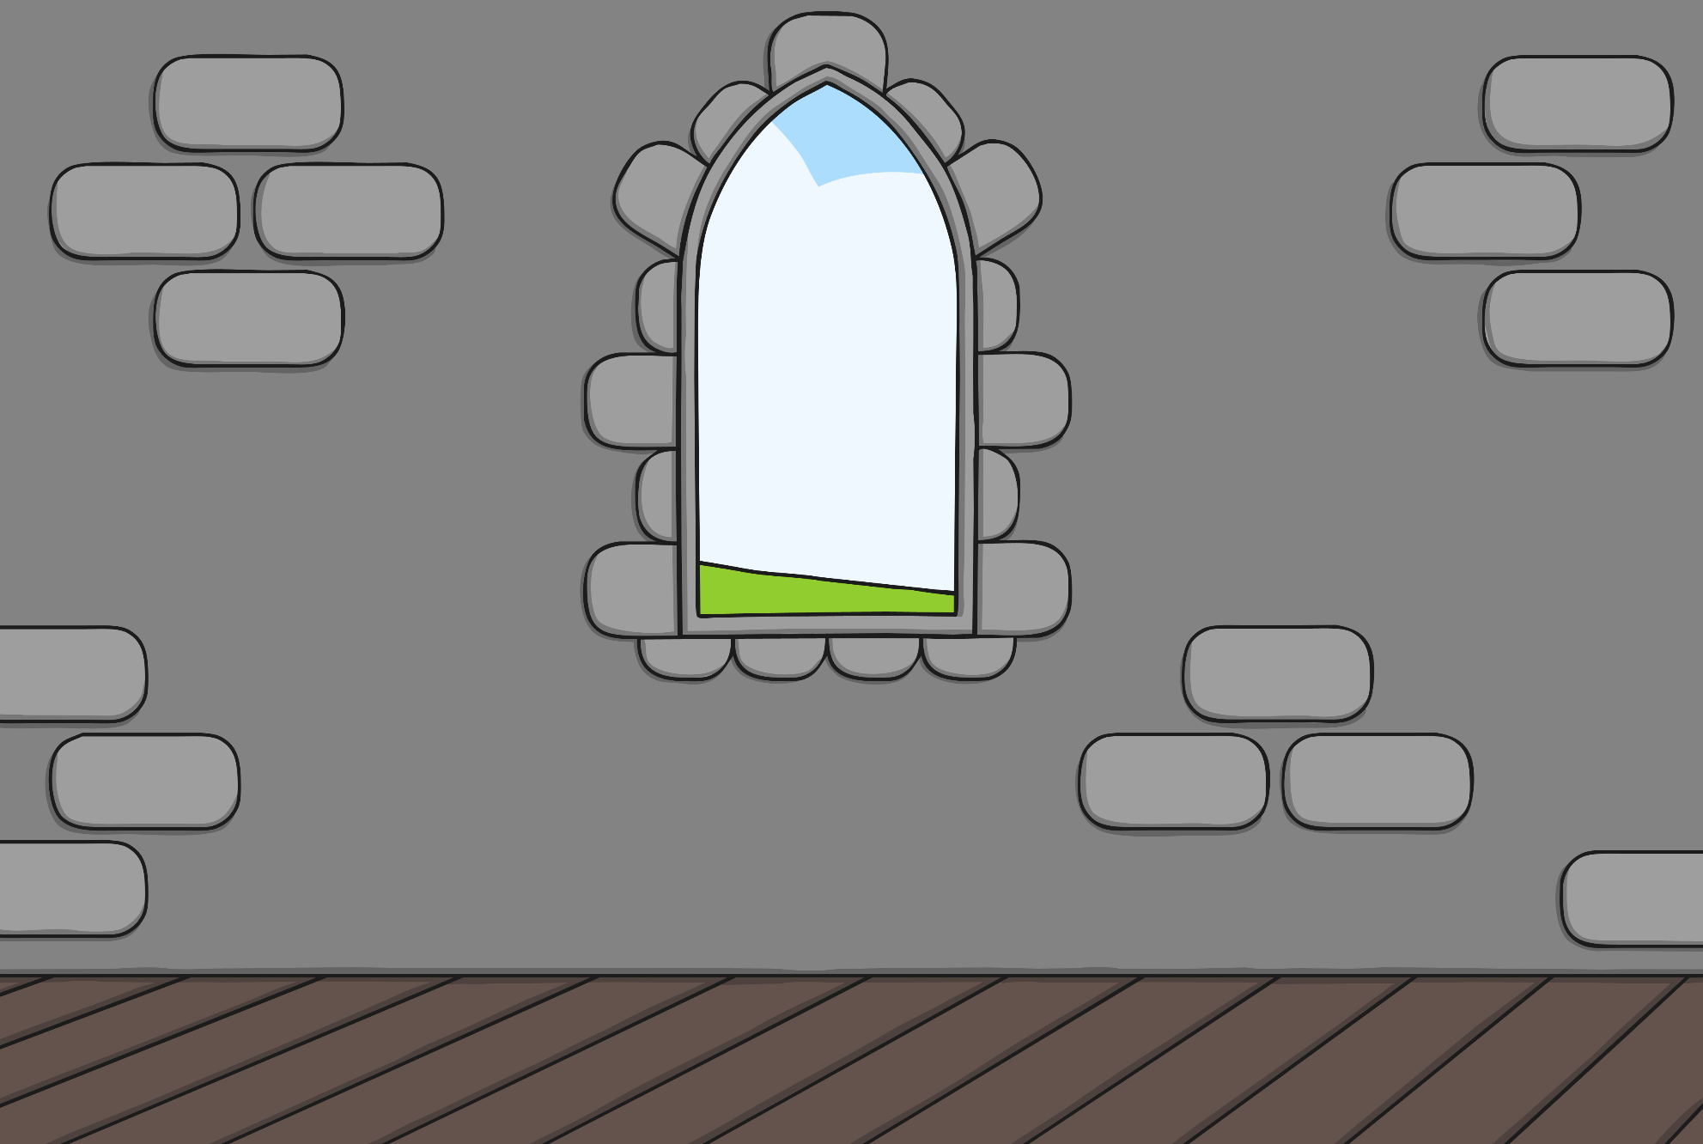

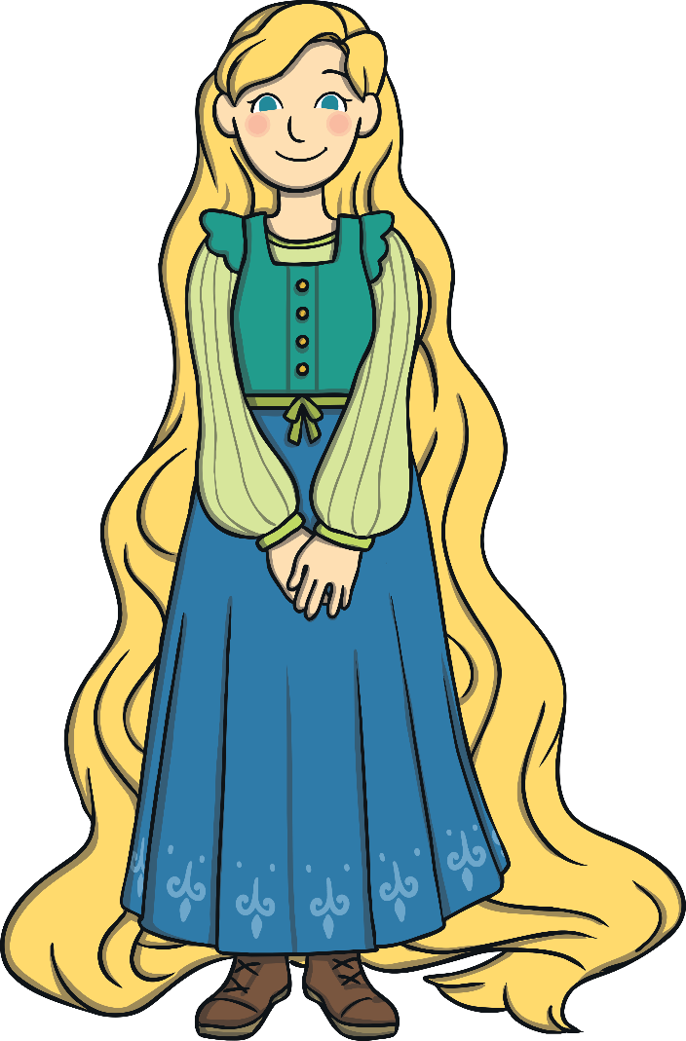
The prince visited Rapunzel every day.
When the witch found out, she was angry.

Slide 12
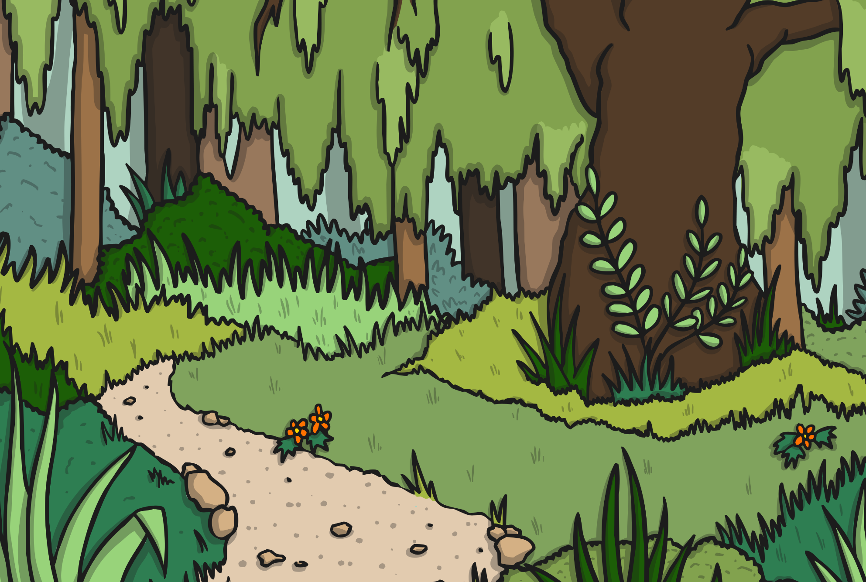

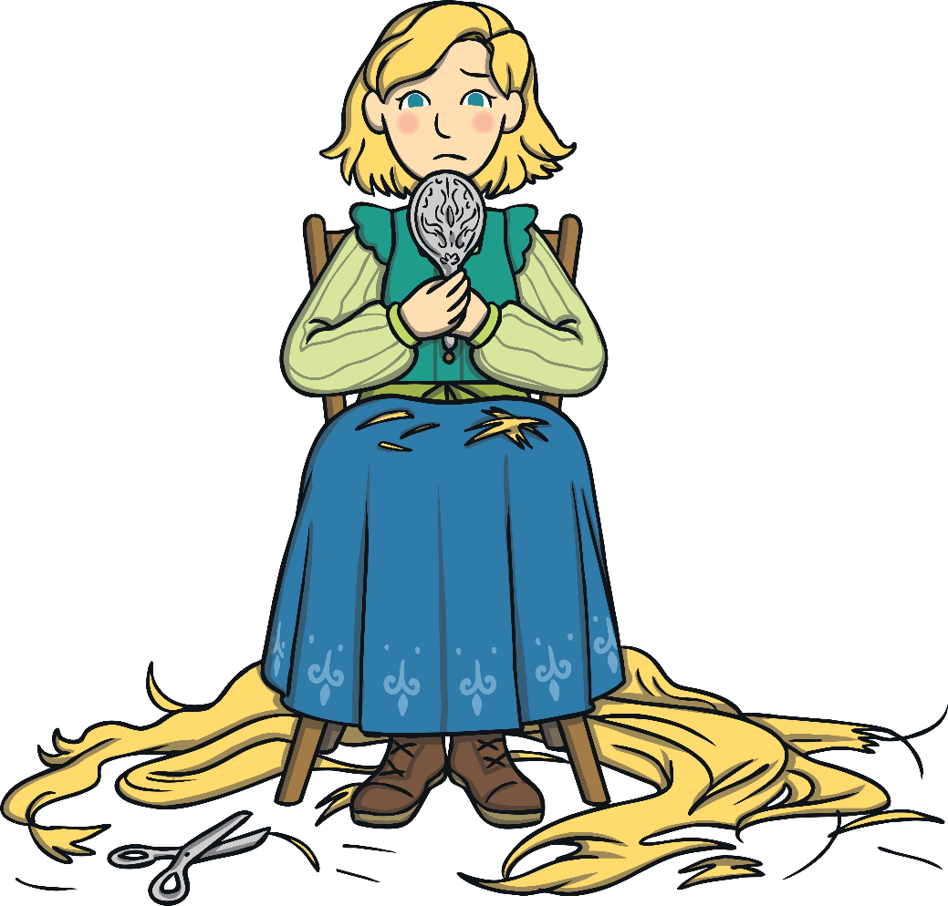
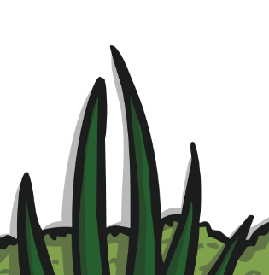
The witch made a plan. She cut Rapunzel’s
hair and sent her off into the forest.

Slide 13
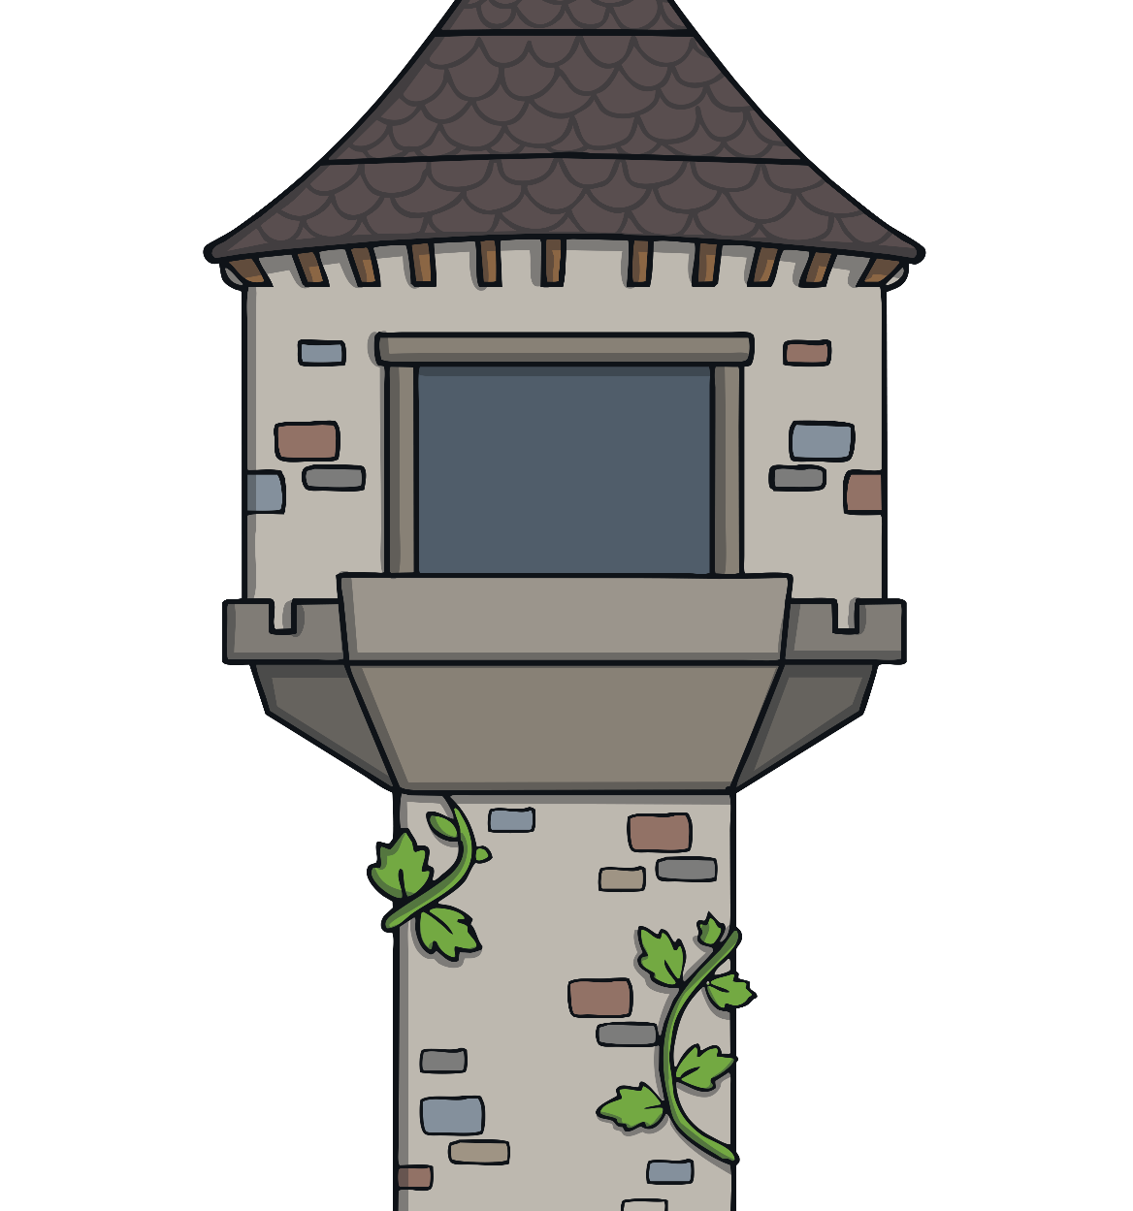
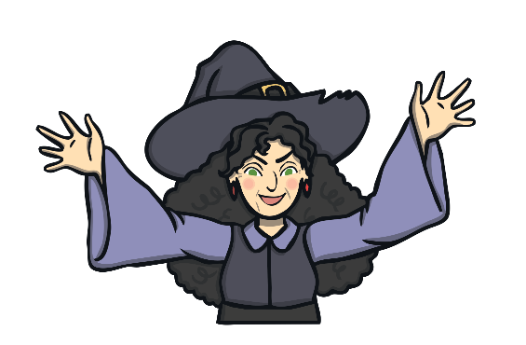

The witch tricked the prince and
threw him out of the tower.

Slide 14
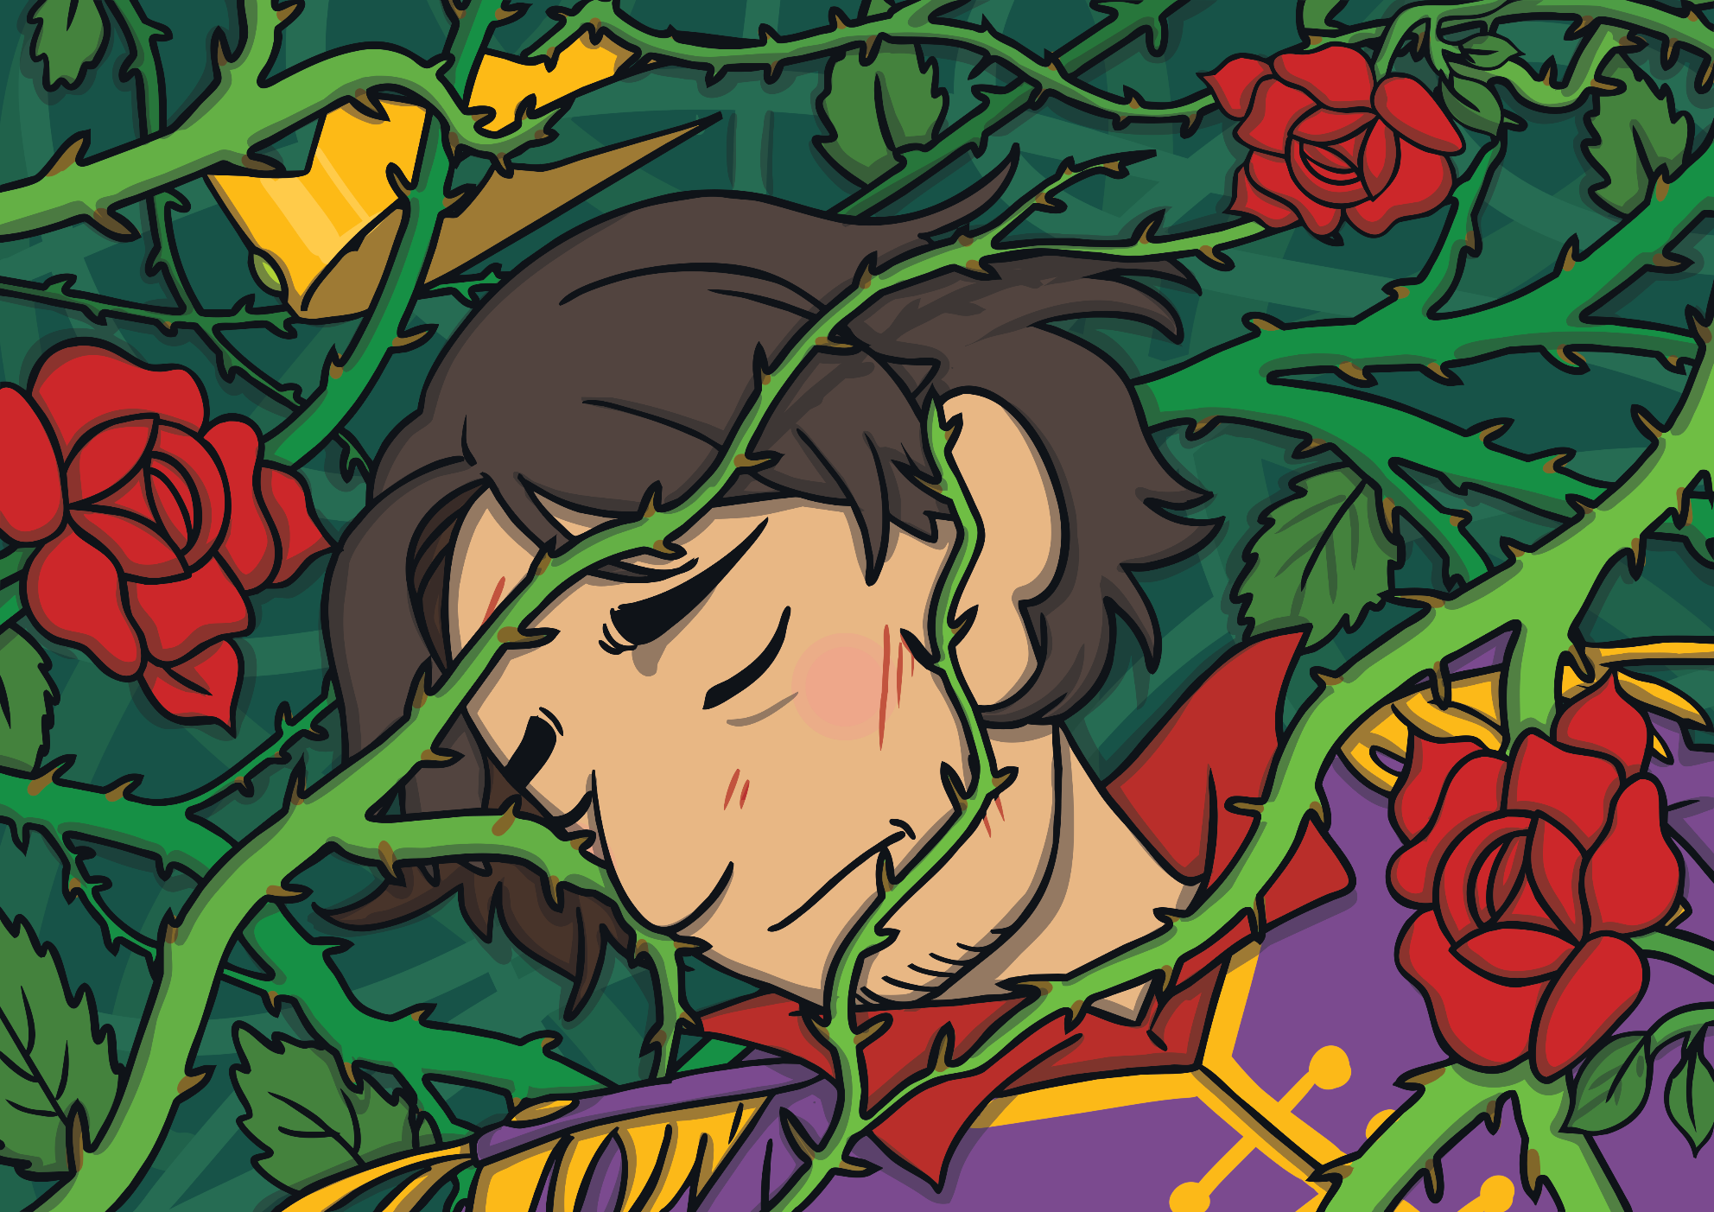

The prince fell on some thorns and scratched
his eyes, which made him blind. For a long
time, he wandered in the forest.

Slide 15




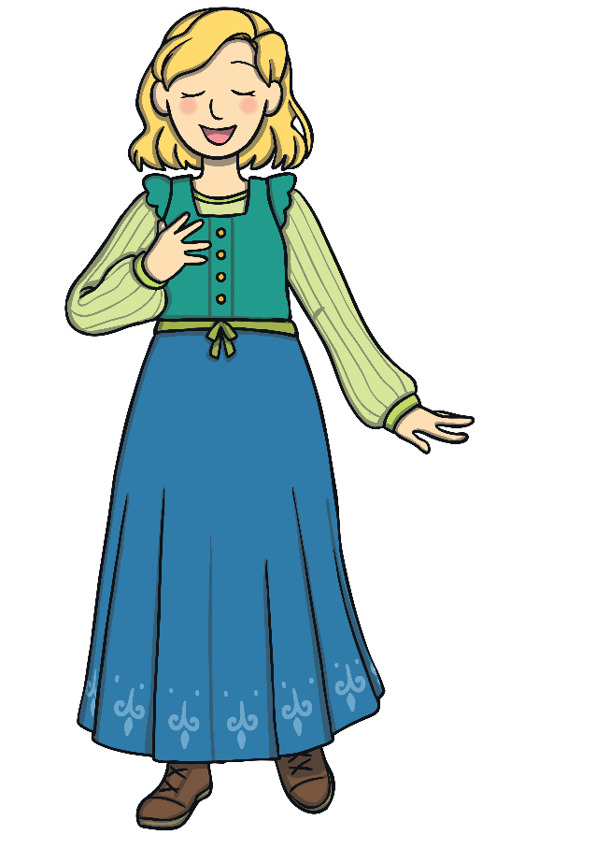
One day, the prince heard Rapunzel singing in the forest.

Slide 16
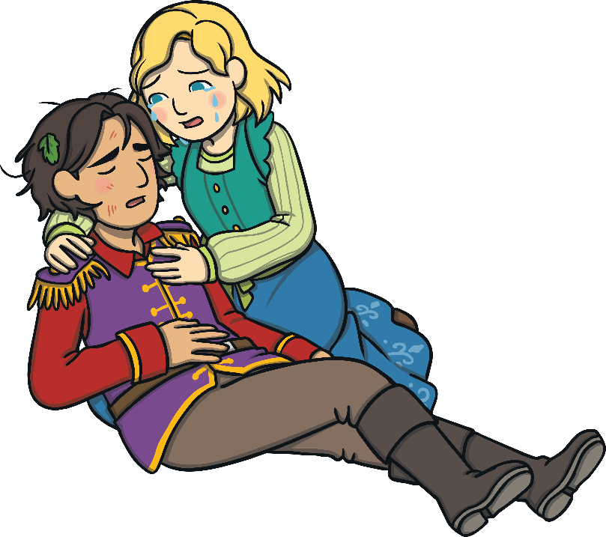




When she saw it was her prince, she cried with happiness. Her tears touched his eyes and he could see again.

Slide 17



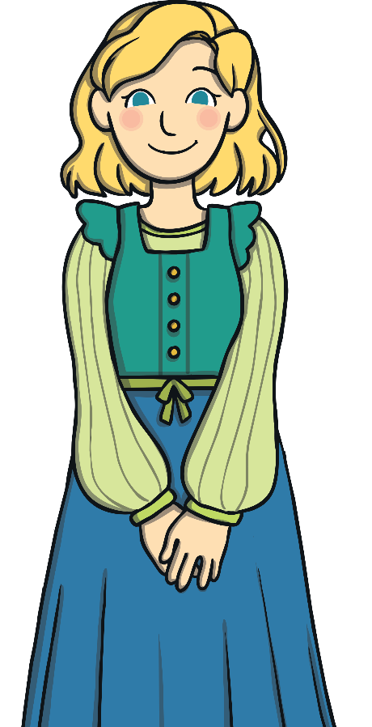
They lived happily ever after in his kingdom.

