Slide 1
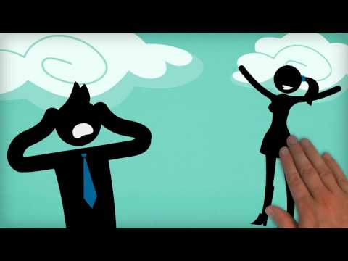
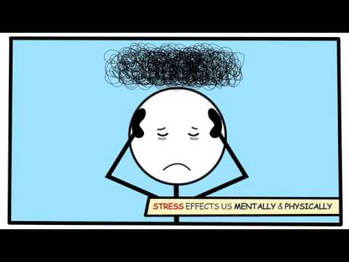
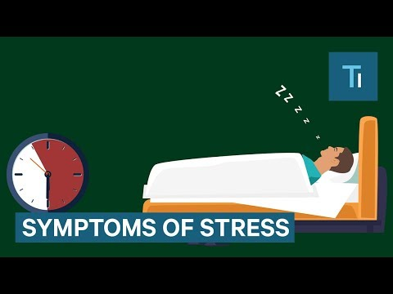
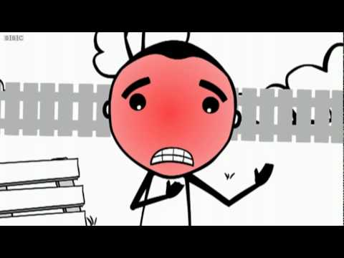
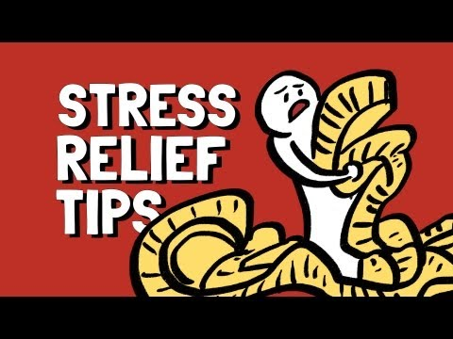
S T R E S S
This is a natural feeling you may have. It feels like a build up of pressure or of tension, and can sometimes impact on the way you think, feel and react to situations. You might feel sad or angry when you are stressed.
What actually is stress?
Possible effects of stress:
Possible impacts on the body:
How can I manage stress?
Strategies to reduce stress:

Slide 2
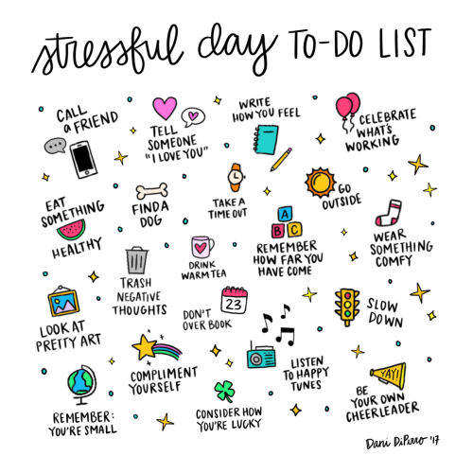
YOUR TASK:
Create a Stressful Day To Do List, like the example.
Draw and label little pictures of things you can do, when you are feeling pressure/tension/stress!
Pop your picture up somewhere you can see it easily, to have a look at when you need to! If you have a device, take a photo. :)

