Slide 1









Slide 2




Slide 3


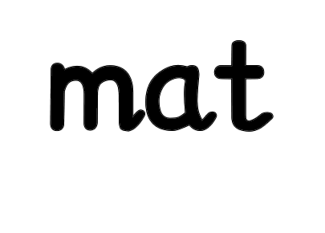



Slide 4

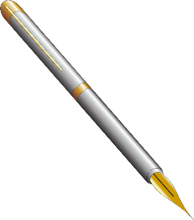



Slide 5



Slide 6







Slide 7








Slide 8



Slide 9


Slide 10



The
for a
is telling
the
how much
are
in
.
We are good for the planet! We recycle scraps and put them back in the earth.

