Slide 1

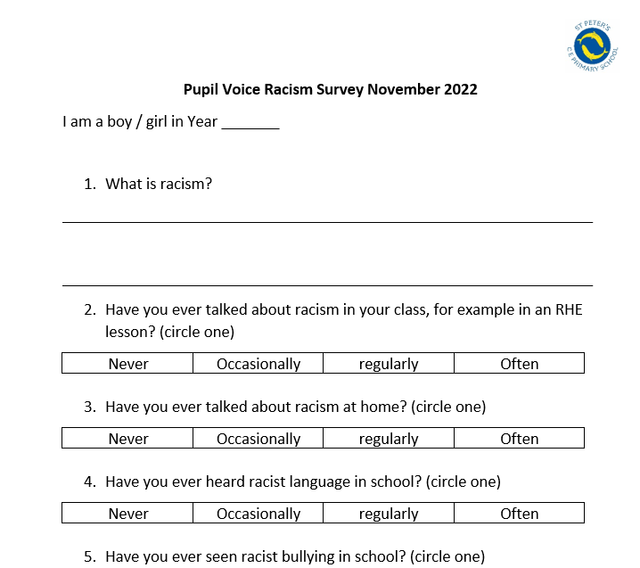
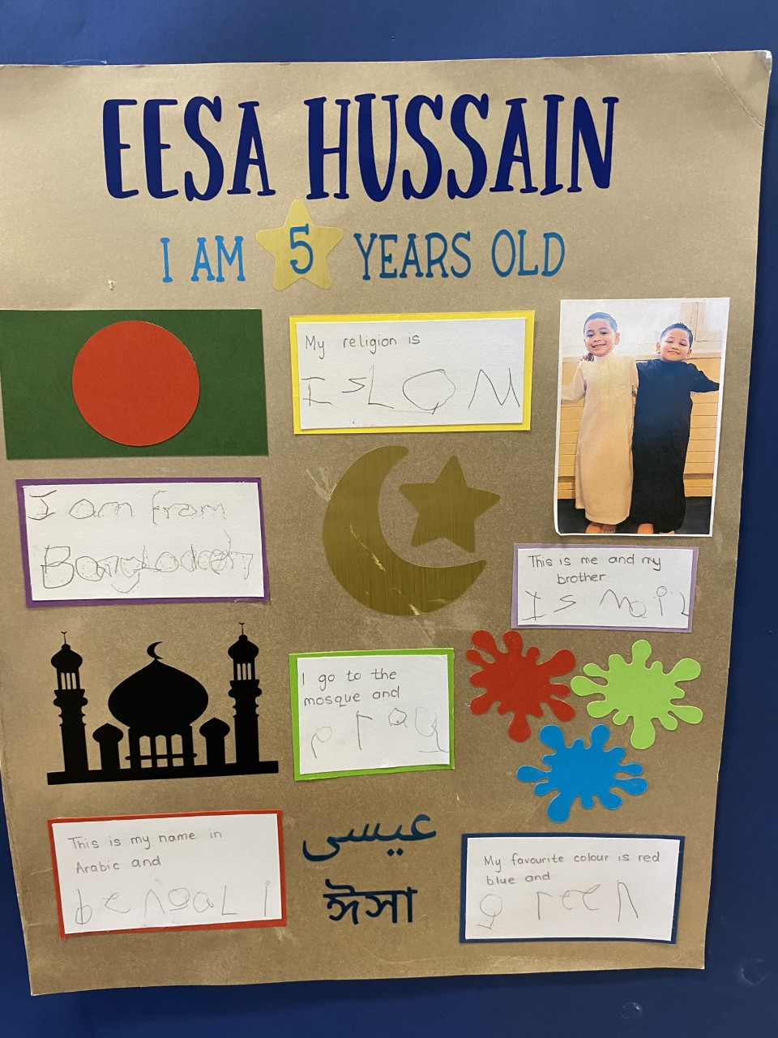
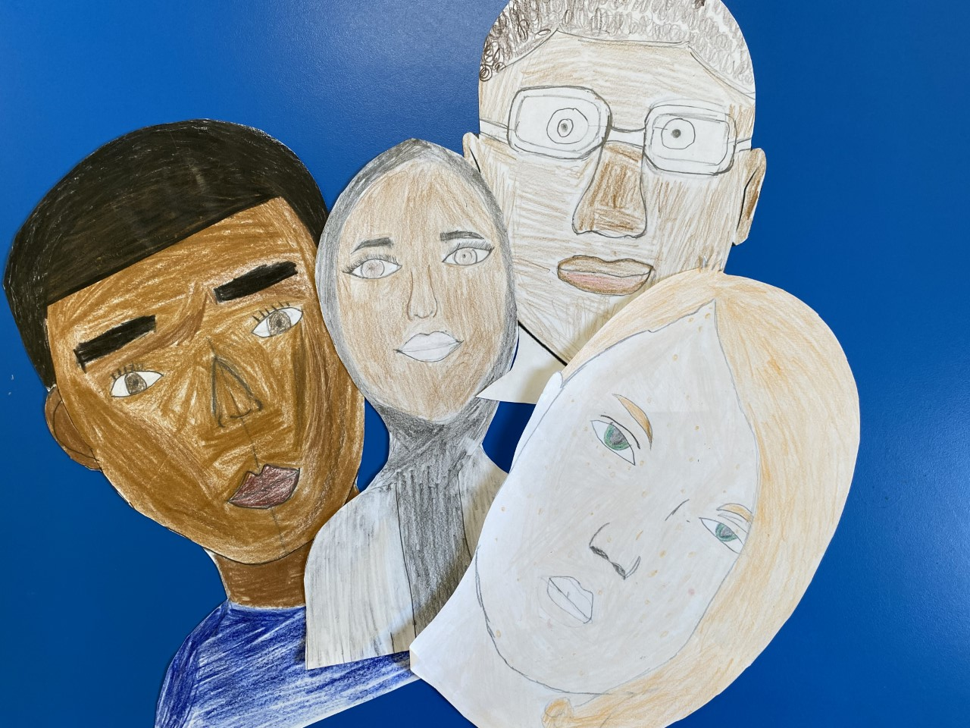
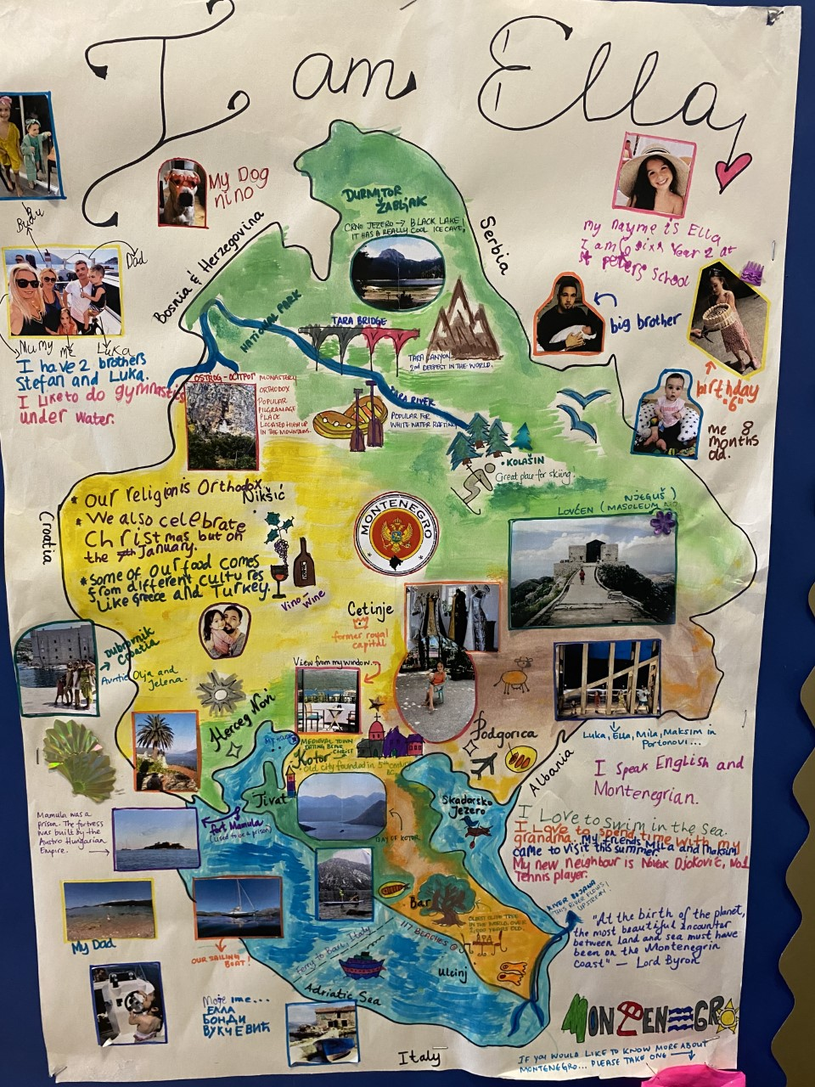
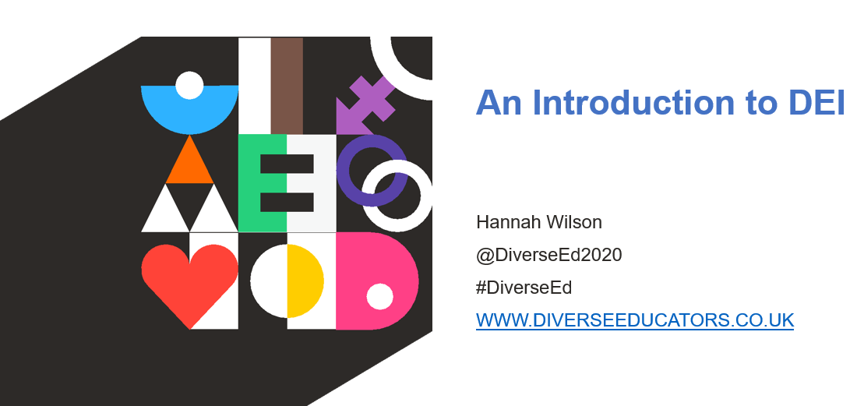
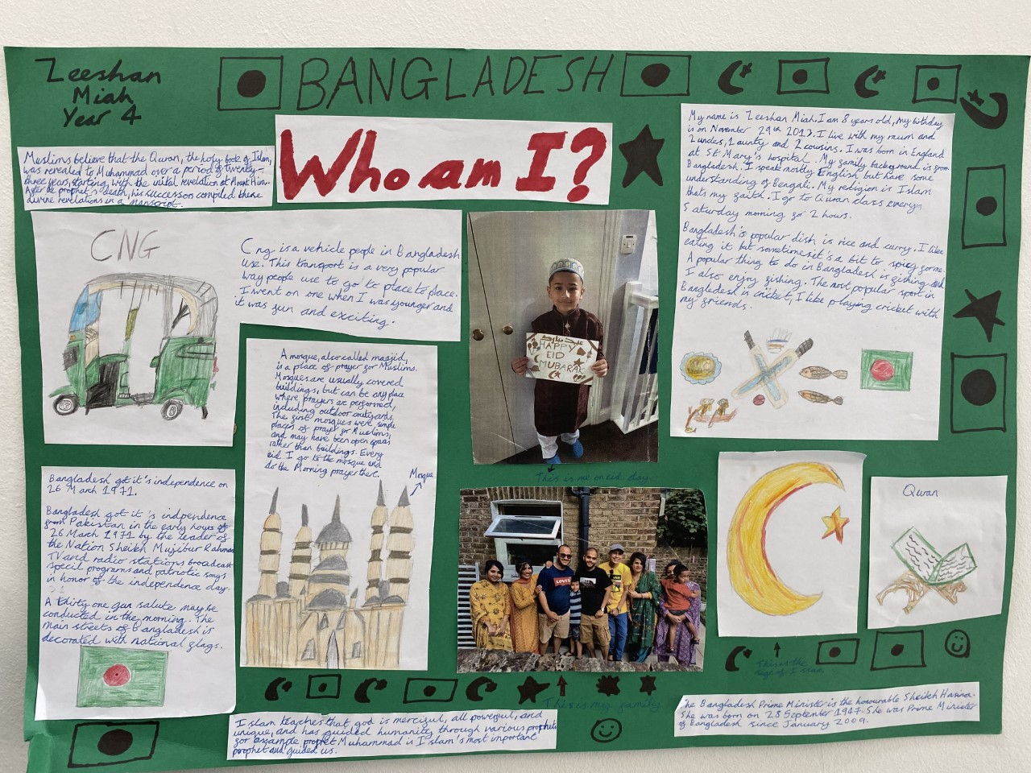
Our School
22% Any other ethnic group
18%-White - British
16%: White - Any other White background
10%: Asian or Asian British – Bangladeshi
8% Asian or Asian British -any other Asian background
7%: Mixed - Any other Mixed background
5%: Black or Black British – Caribbean
35 languages spoken
Race and Diversity at St Peter’s
RISL (Race, Identity and School Leadership
- Sam Adcock and Alice Ducros
Why? Racial equality and social justice is something we at St Peter’s strive for. We believe children are our future leaders who can bring about change in the world. As educators we have a key role to play in ensuring our community feel included and listened to.
Aims:
– Identify key principles of racial equality and social justice and what best practice looks like in individual school contexts
– To enable children and staff to become racially literate and agents of change
–Create personal and organisational narratives that support the achievement of pupils of different races and backgrounds
– Develop the necessary psychological and emotional tools for engaging in courageous conversations about race
– Increase our own sense of personal agency and ability to act as an agent of change
Racism surveys carried out with staff and pupils
Work we have already carried out
Whole School homework project- all about me- Getting children to reflect on their own racial identity and to feel proud
DEI whole school training
Self portraits focussing on race and talking about skin colour and tones

Slide 2
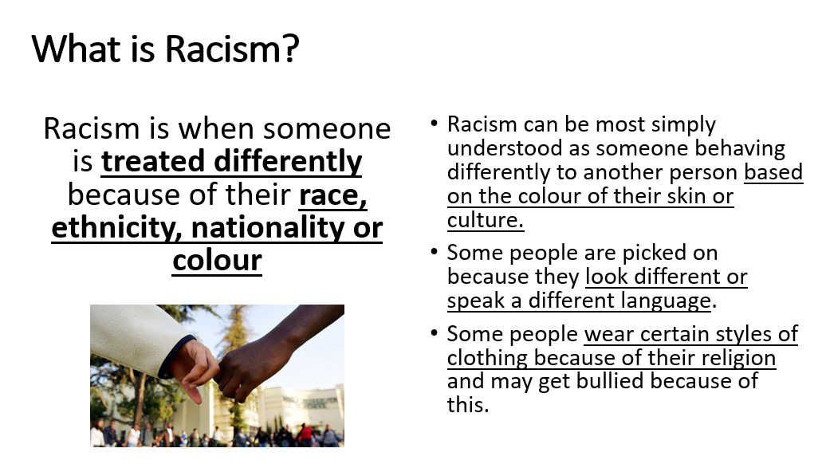
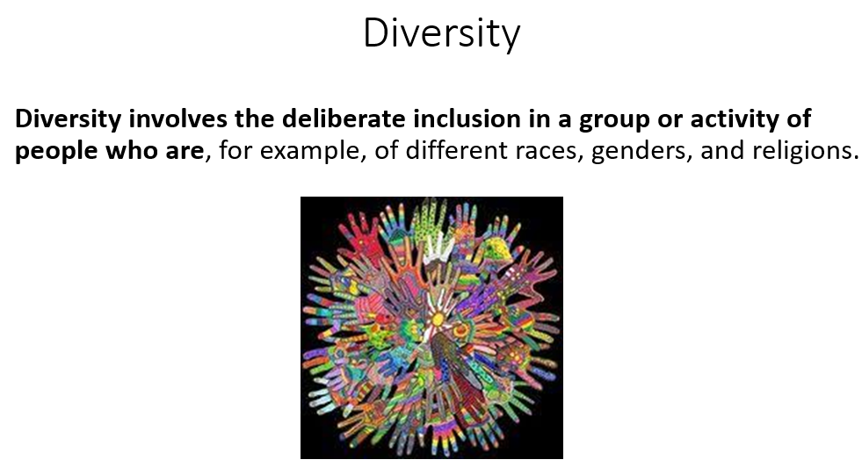
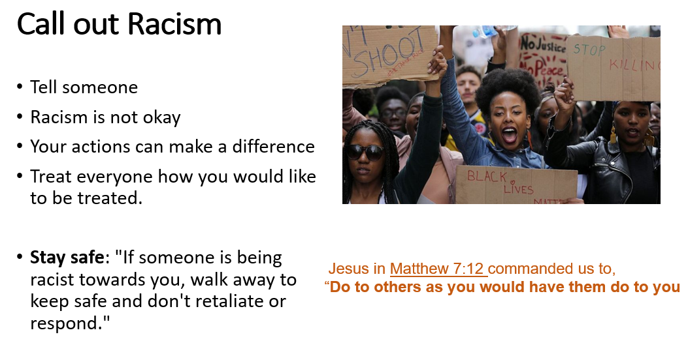
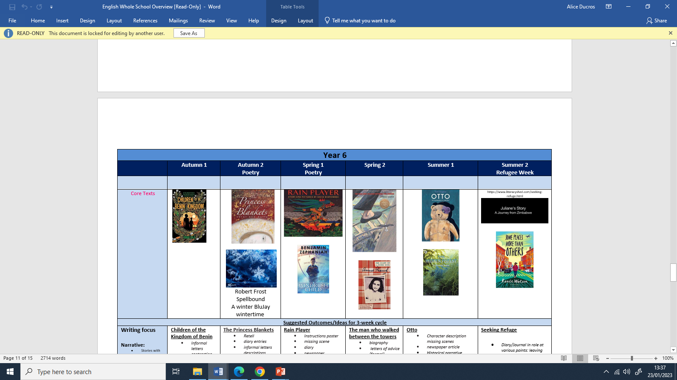
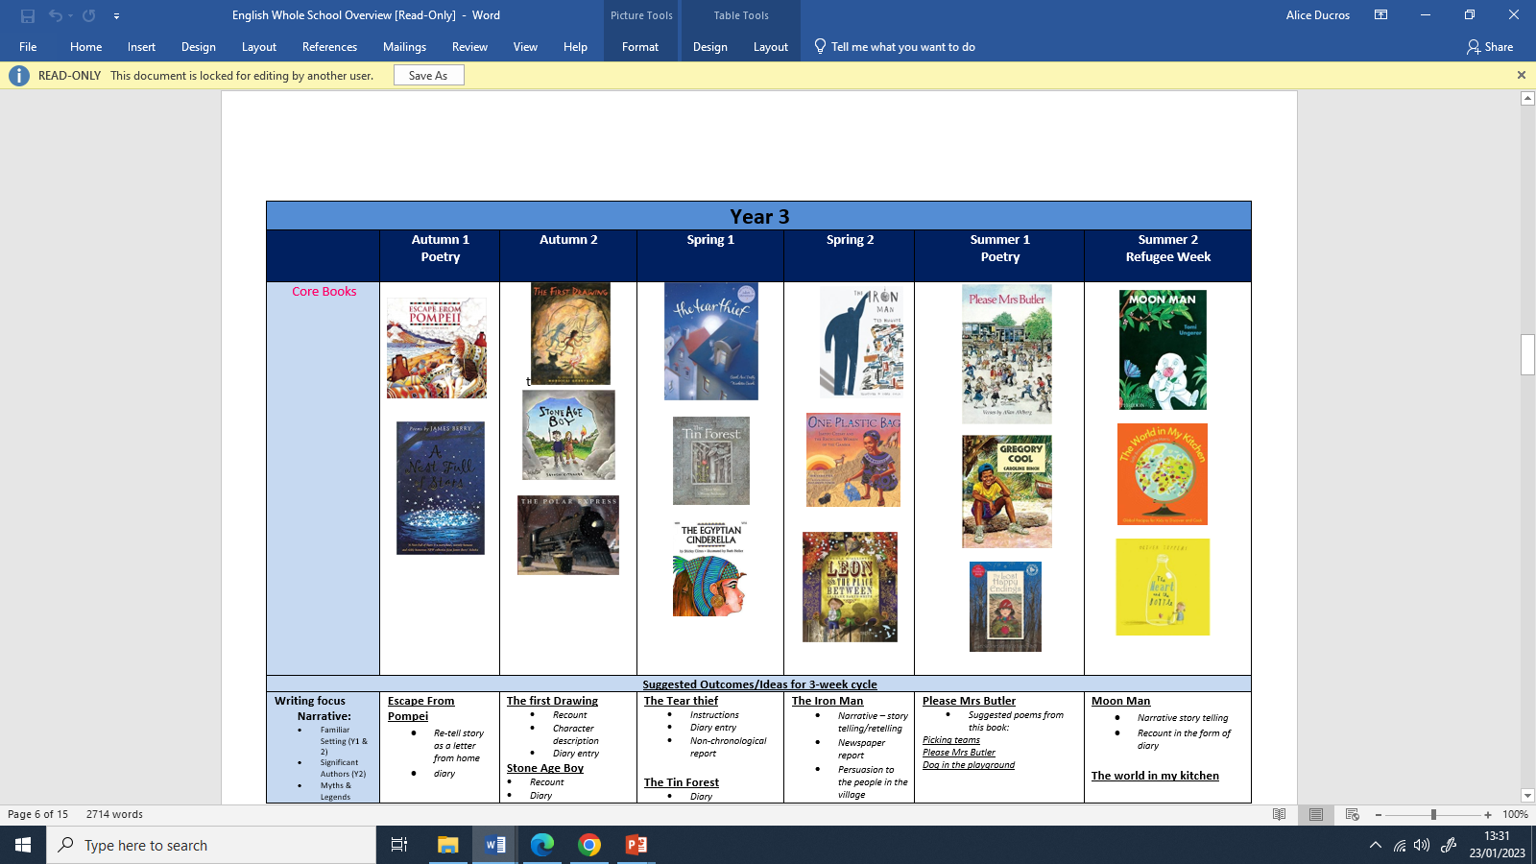
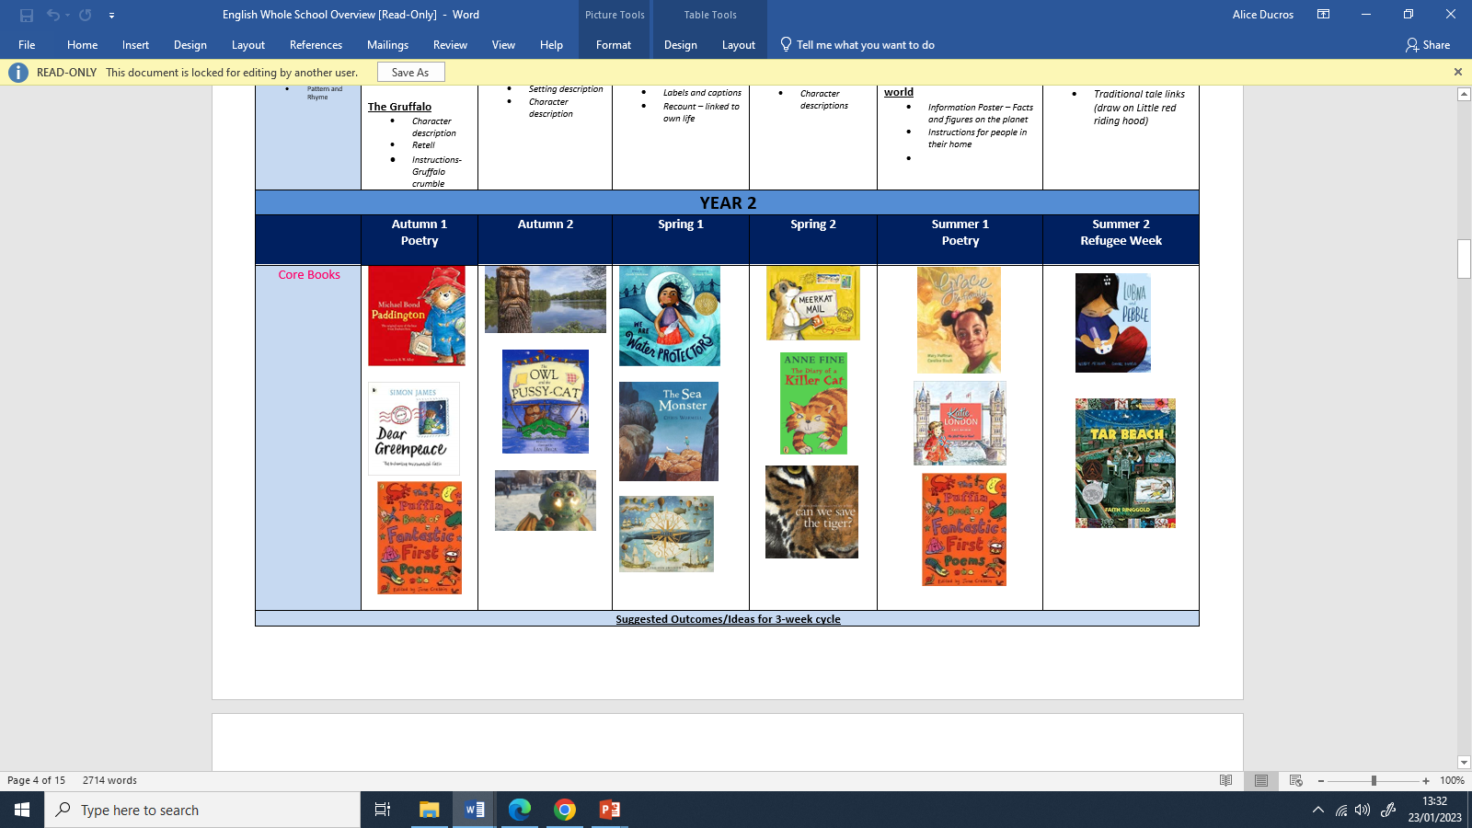
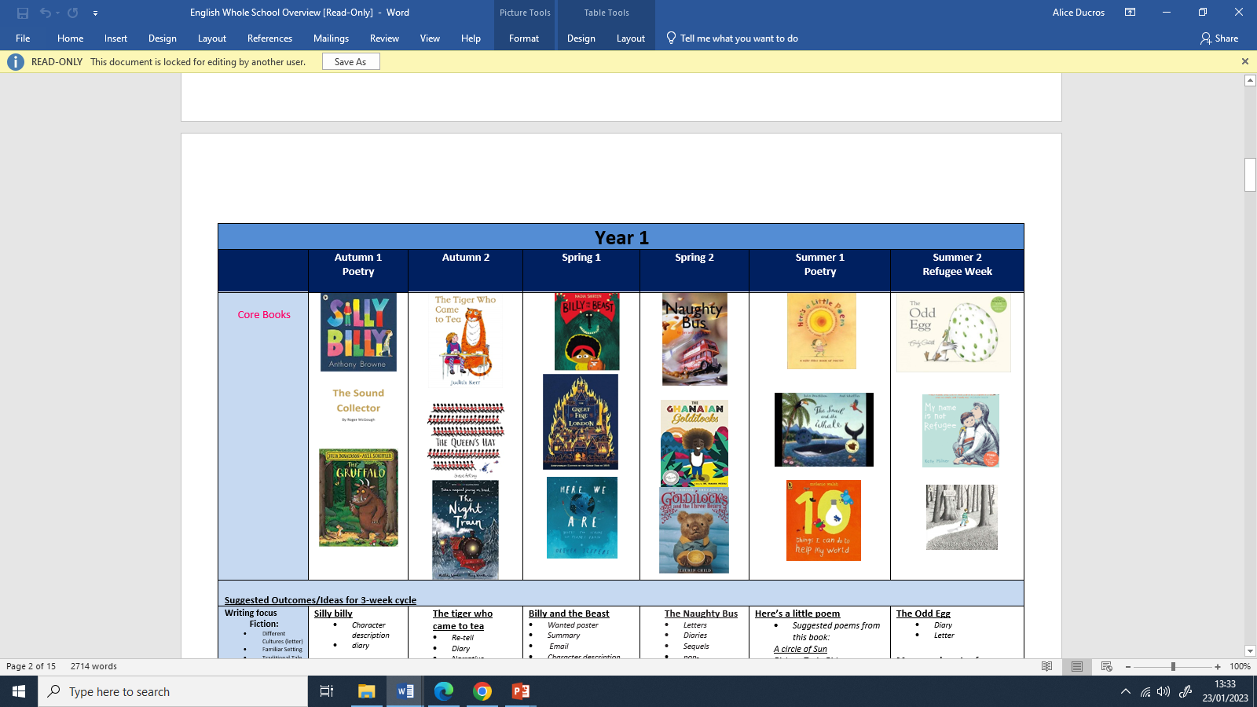
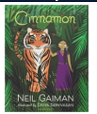
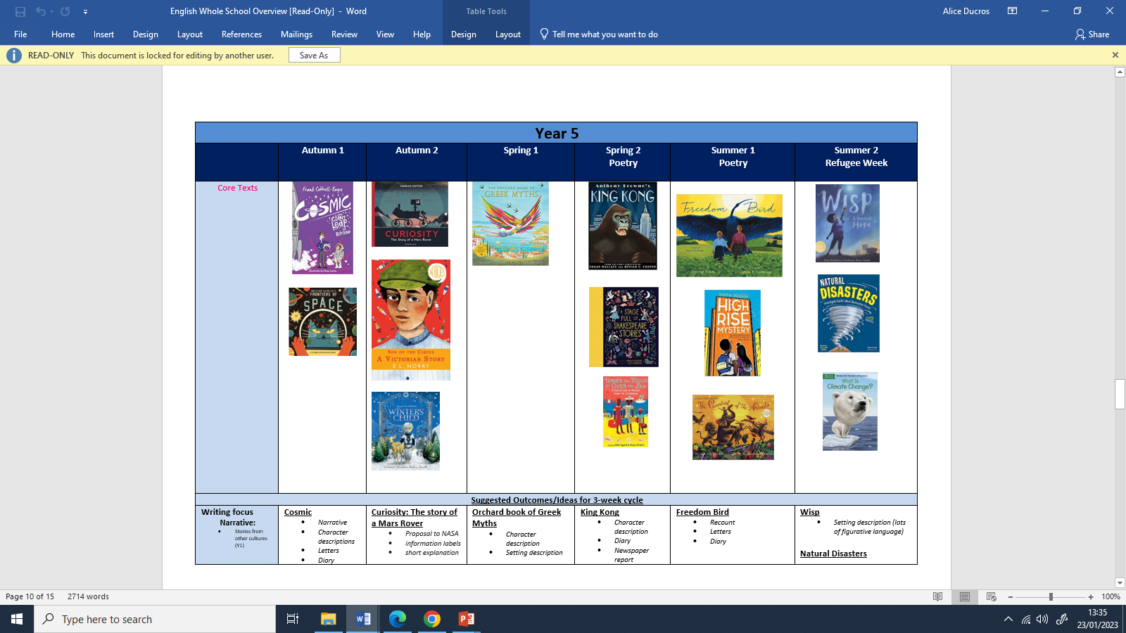

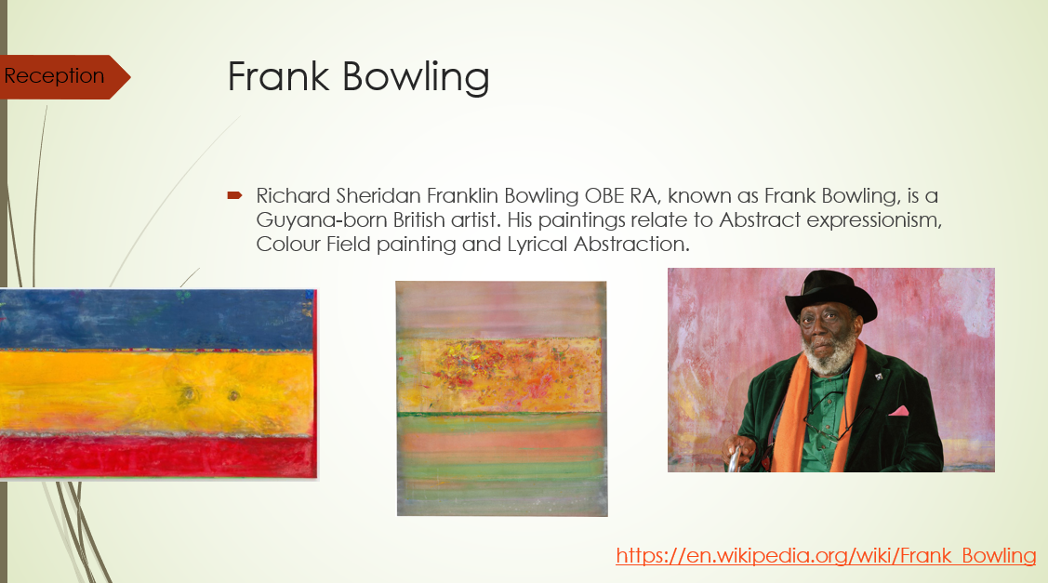
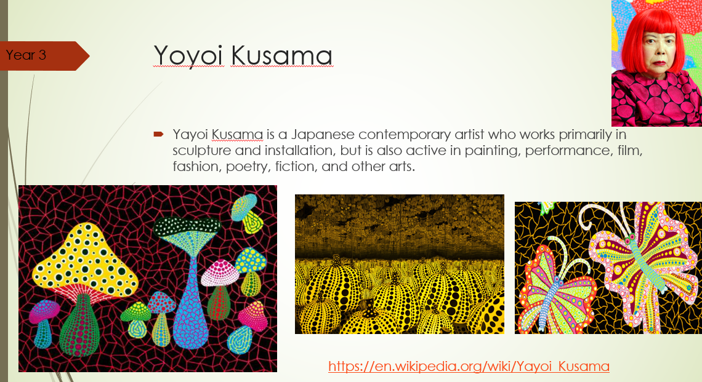
Race and Diversity at St Peter’s
Whole school assemblies on racism and diversity- teaching the children about courageous advocacy
What have we learnt?
How important this work is
The importance of racial literacy
The need to be brave and courageous
Be open, honest and listen
Anti racist champion - call it out
Education is a moral and social endeavour
Look through the diversity lens
This is an ongoing journey
We have looked carefully at our curriculum to ensure the children are represented in texts and images we use.
Ensured our curriculum is using people of colour as role models

