Slide 1


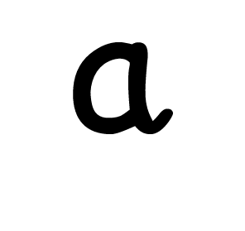
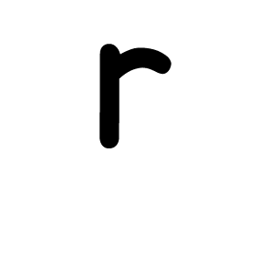





Slide 2





Slide 3






Slide 4





Slide 5


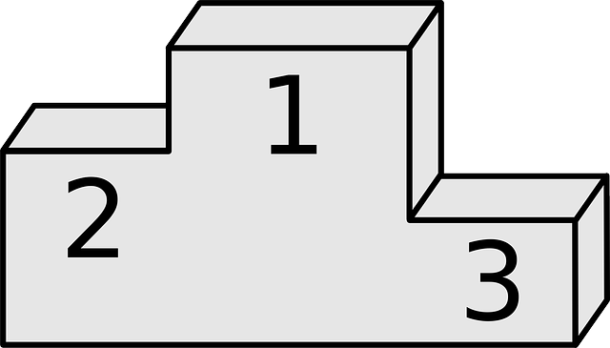


Slide 6





Slide 7



Slide 8





Slide 9


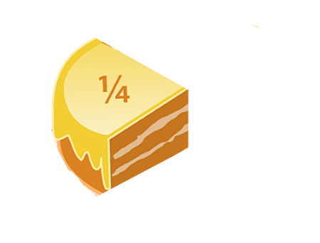



Slide 10
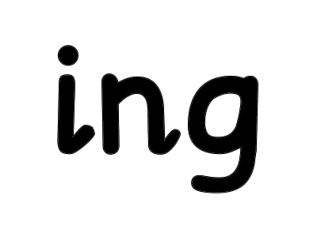

Slide 12


Slide 13


Slide 14
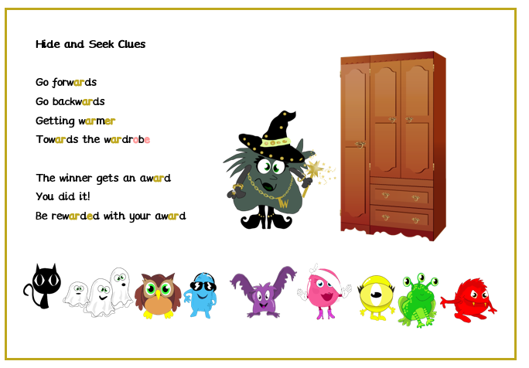
Go to https://www.youtube.com/watch?v=Z0FIZAw_bps to watch Tricky Witch read this poem.

Slide 15


