Slide 1

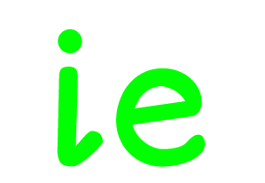

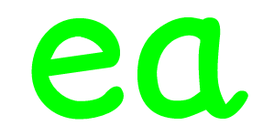
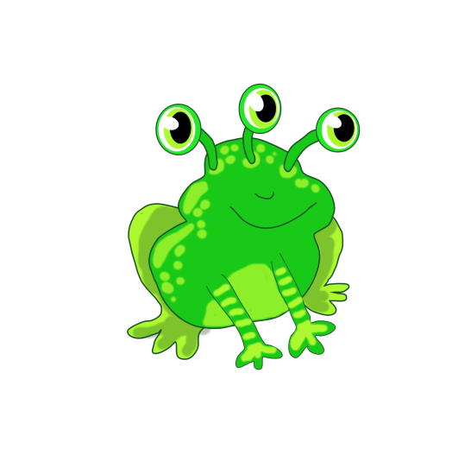



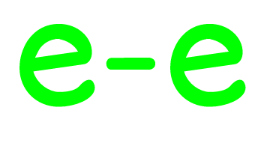
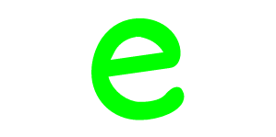
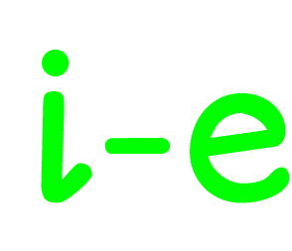
Green Froggy

Slide 2

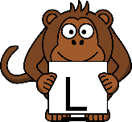



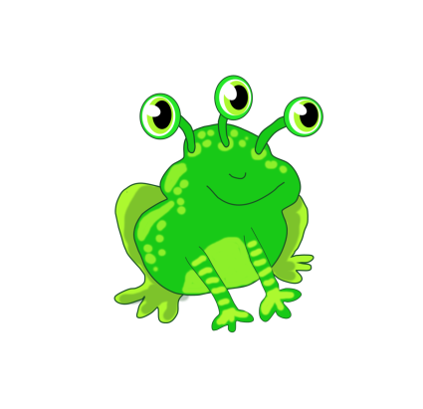






Click on a monkey !

Slide 3
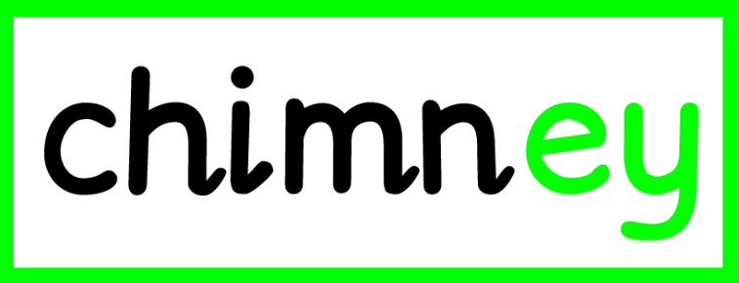



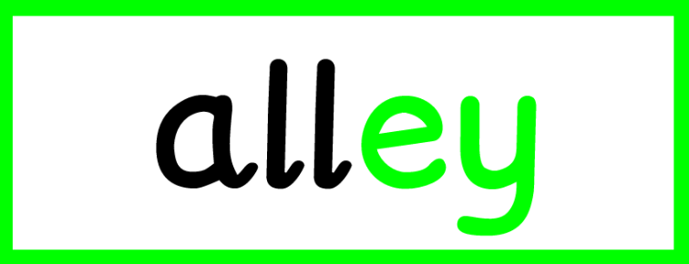
Click on a monkey !

Slide 4

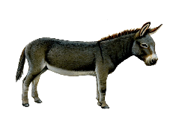



The MORE THAN ONE Machine
donkey
donkeys

Slide 5

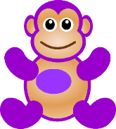

The MORE THAN ONE Machine
monkey
monkeys

Slide 6



The MORE THAN ONE Machine
money
money

Slide 7

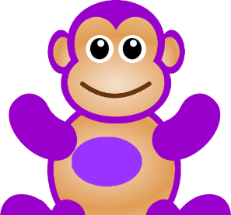

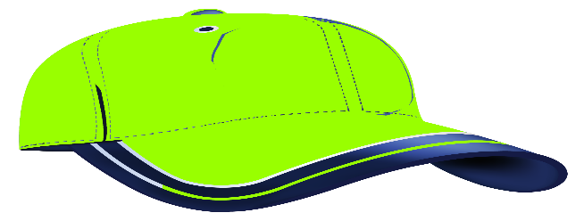
I want to take Monkey Boo to school!

Slide 8
Return to Monster
Phonics to watch the Video
Monkey Boo

