Slide 1






Guidance for Video/Audio in PowerPoints
1. Open the folder and copy all the files.
2. Paste the copied files into a new folder.
3. Open the PowerPoint file, enable editing and enter presentation mode (start the slide show).
Please note the embedded audio may not be compatible with early versions of PowerPoint.
You may wish to delete this slide before beginning the presentation.

Slide 3

Revisit and Review
Let’s revisit last week’s focus words…
I’ll say them and you write them down!

Slide 4


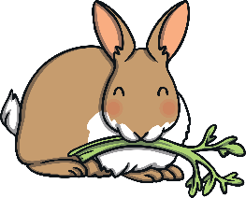


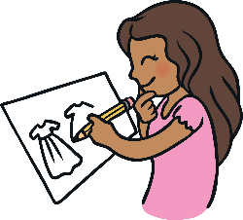



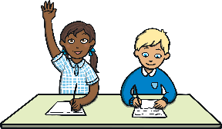
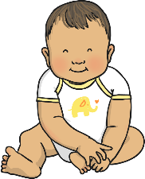
Revisit and Review

Slide 5

Teach
This week, we are learning to spell the common exception words mother and another.
Watch the magic pencil write the words. Can you join in?

Slide 6



Teach
mother
Play

Slide 7
Teach
another
Play

Slide 8

Teach
Today, we are learning to read words containing
kn saying /n/.

Slide 9
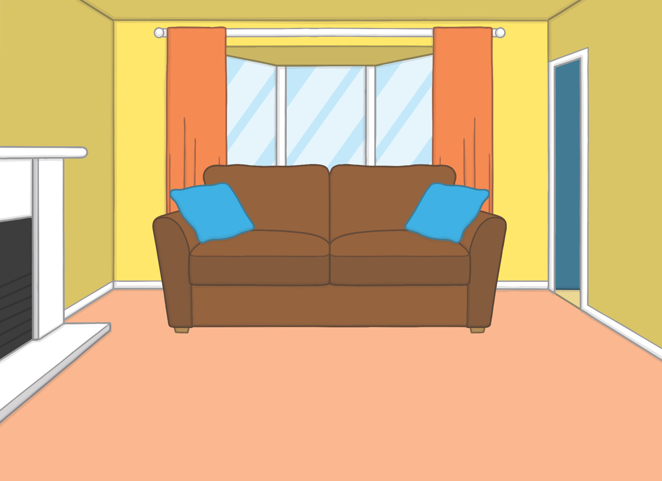



Teach
Kit and Sam were bored. It was raining and they had been inside all day. “Hey, we haven’t used the magic book for a while,” said Kit.
“Hmm… but where would we go?” sighed Sam.

Slide 10
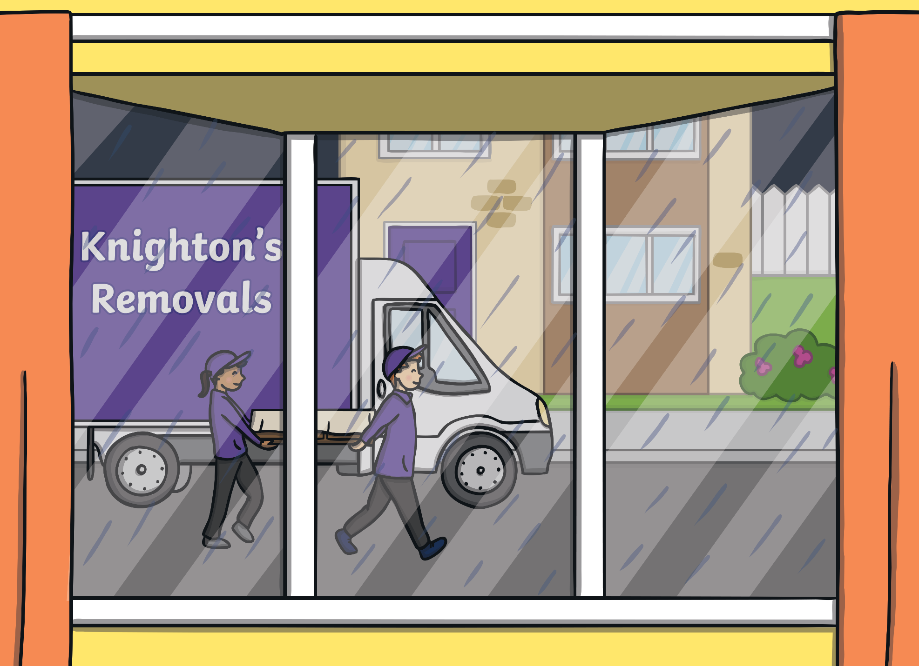
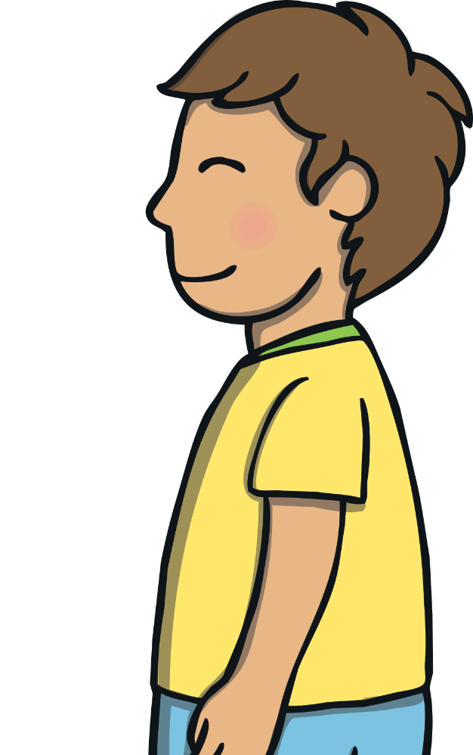
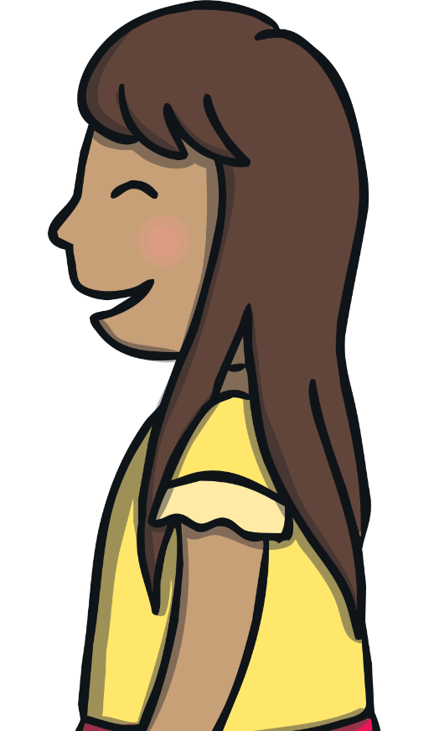
Teach
“Hey, do you know what is happening outside?” asked Sam, suddenly running across to the window. “There is a big truck moving furniture into the empty house across the road!”

Slide 11
Teach
“Ooh, look!” said Kit. “There are children our own age moving in. Let’s let them finish unloading, then we’ll go and introduce ourselves.”

Slide 12
Teach
In some words, the /n/ sound has a k before it. The k is silent.
knight
knife
knot

Slide 13


Teach
Kit and Sam are watching the boxes being unloaded from the van. Click on the boxes to reveal a kn saying /n/ word to read.
X
‘k’ is usually silent when it comes before an ‘n’. This is often because of the way words were spelt in Old English.
Click me for Kit’s teaching tips!

Slide 14
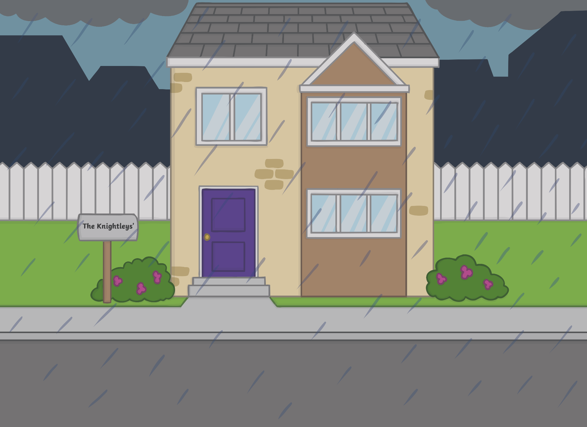


Teach
knock
knight
knot
know
knee
knife
knapsack
knowledge

Slide 15
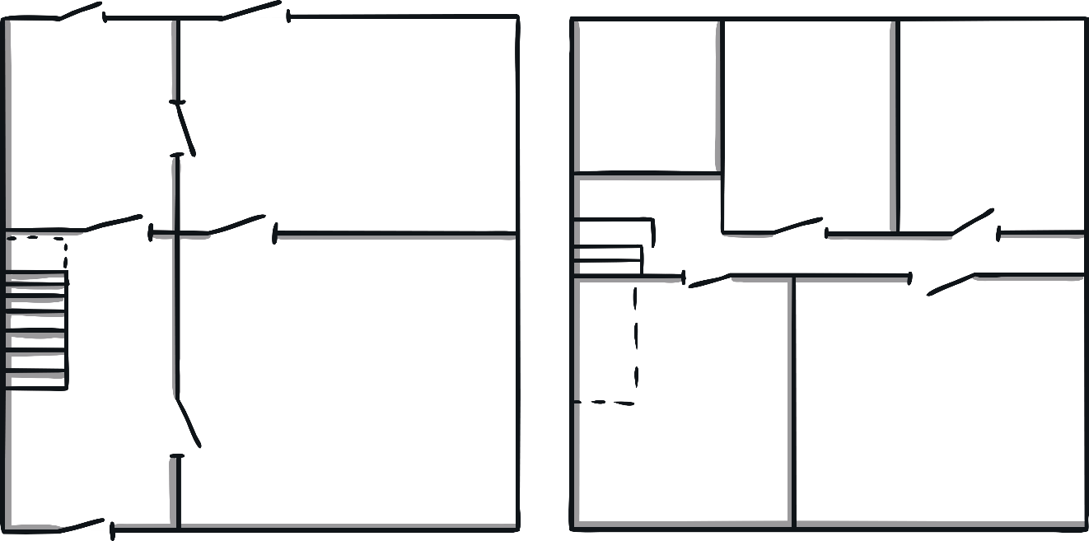
Sorting the Boxes
Practise
Each box needs to go in the correct place in the house. Can you put the box in the right room?

Slide 16
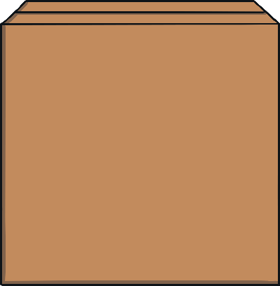
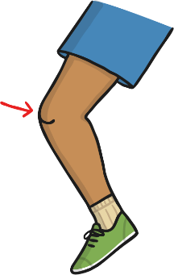
Practise
knee
knife
knight
knot

Slide 17

Practise
knee
knife
knight
knot

Slide 18
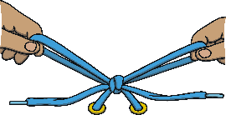
Practise
knee
knife
knight
knot

Slide 19

Practise
knee
knife
knight
knot

Slide 20

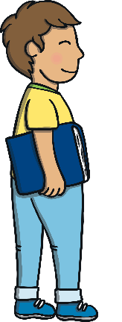
Apply
As soon as the last box had been unloaded, Kit, Sam and Ben rushed over to knock on their new neighbour’s door. Kit was still carrying the magic book. “Don’t lose it!” hissed Sam.

Slide 21
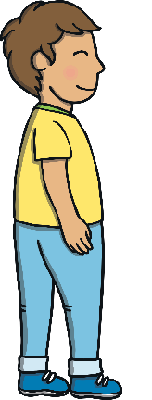
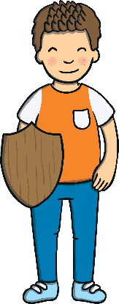
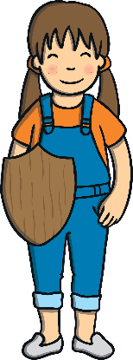

Apply
The door was flung open by two children holding wooden shields. Before he could speak, a crumpled sheet of paper was thrust into Kit’s hand. He dropped the magic book in surprise.

Slide 22

Text Detectives!
Apply
What does the sheet of paper that the children give to Kit say? Find all the kn saying /n/ words.

Slide 23


Apply
The Knight’s Code of Conduct
Seek knowledge, not power.
Kneel before royalty.
Help fellow knights.
Always carry useful items in your knapsack (such as a toy knife, some rope to knot and yummy
chocolate bars).
Signed………………
The Knight’s Code of Conduct
Seek knowledge, not power.
Kneel before royalty.
Help fellow knights.
Always carry useful items in your knapsack (such as a toy knife, some rope to knot and yummy
chocolate bars).
Signed………………
Check

Slide 24
Apply
“There, sign that and you can come in,” said the little girl, handing Sam a pen. “Don’t forget that old book,” said the little boy, pointing at the magic book on the floor.

Slide 25

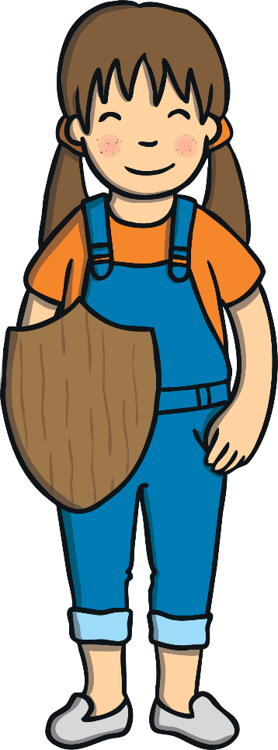
Today, we have learnt…
kn
saying /n/
The adventure continues next lesson!

