Slide 2

Revisit and Review
Let’s revisit last week’s focus words…
I’ll say them and you write them down!

Slide 3

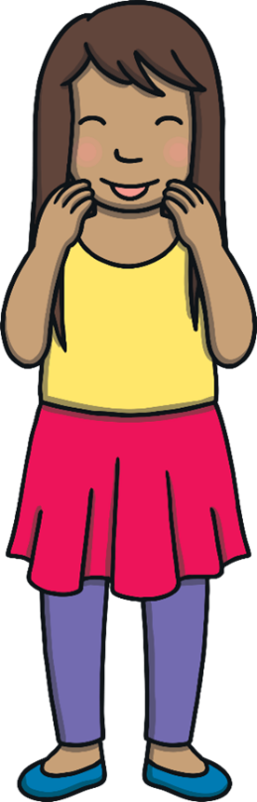
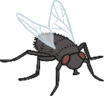
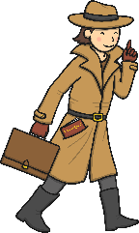
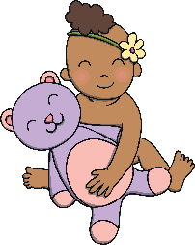
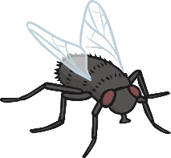
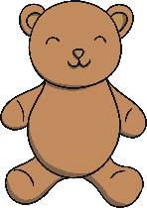
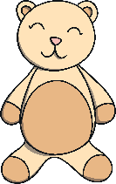
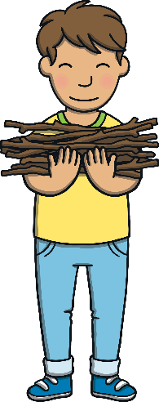
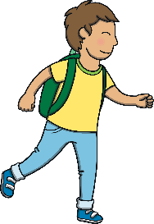

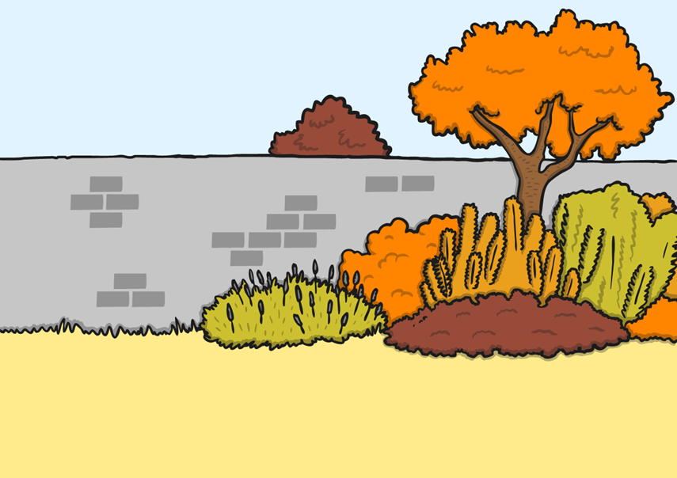
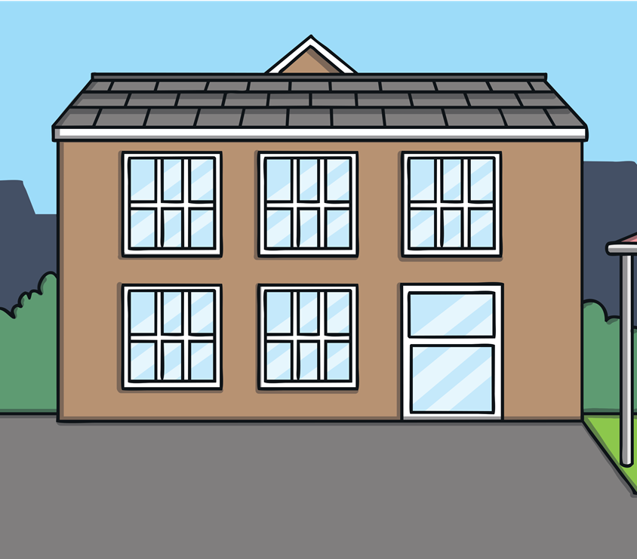
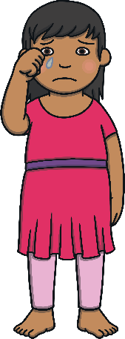
Revisit and Review

Slide 4

Teach
This week, we are learning to spell the common exception words know and baby.
Watch the magic pencil write the words. Can you join in?

Slide 5



Teach
know
Play

Slide 6
Teach
baby
Play

Slide 7
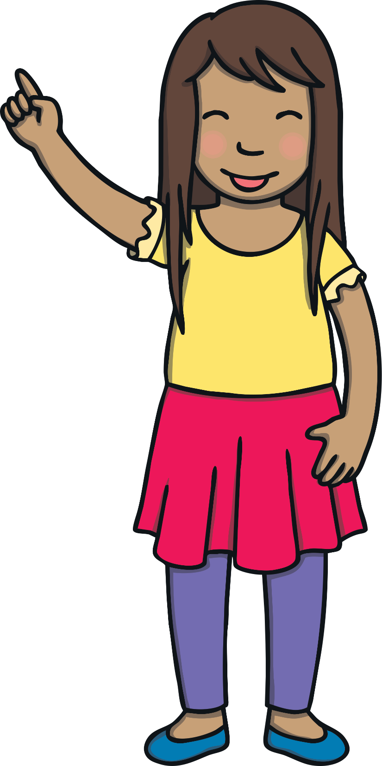
Teach
Today, we are learning to read words containing
gn saying /n/.

Slide 8
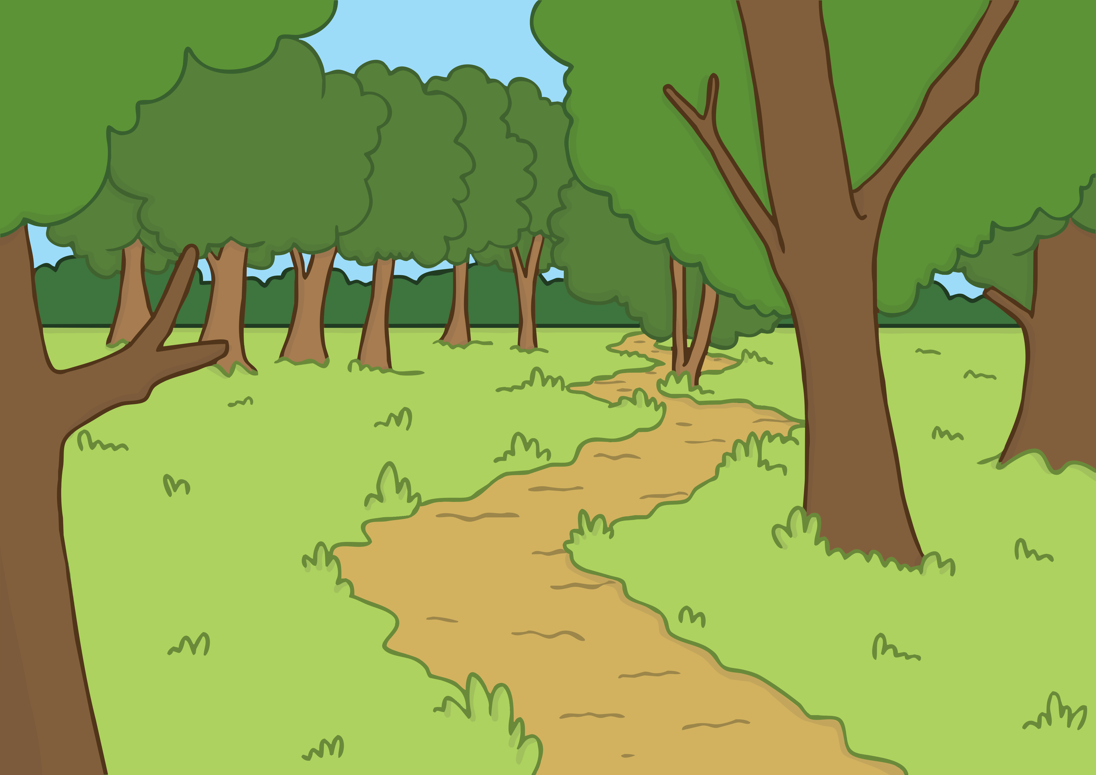
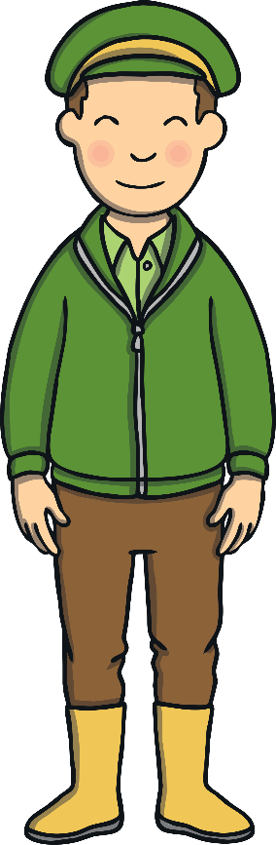


Teach
Today, Kit and Sam’s class had a special visitor. It was John, the local park-keeper. He had come to help the class with the school’s outdoor wildlife area.

Slide 9
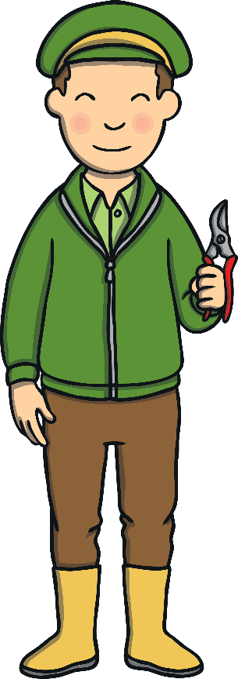
Teach
John explained that autumn was a good time for pruning trees and bushes. He showed them how to use the pruning shears carefully.

Slide 10
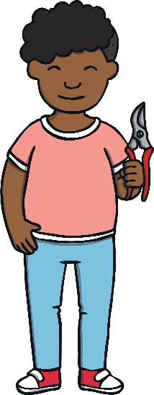
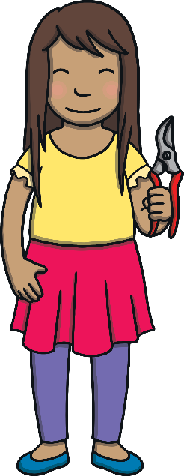
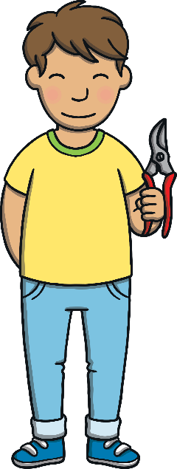
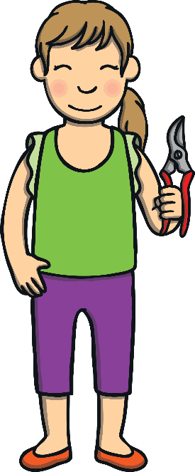
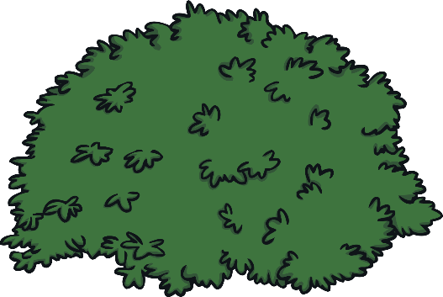
Teach
Kit and Sam couldn’t wait to have a go themselves. The class spread out around the nature area and began to cut back the shrubs.

Slide 11
Teach
In some words, the /n/ sound has a g before it. The g is silent.
gnome
sign
gnaw

Slide 12
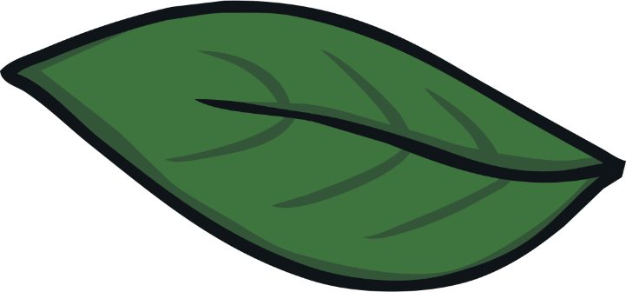
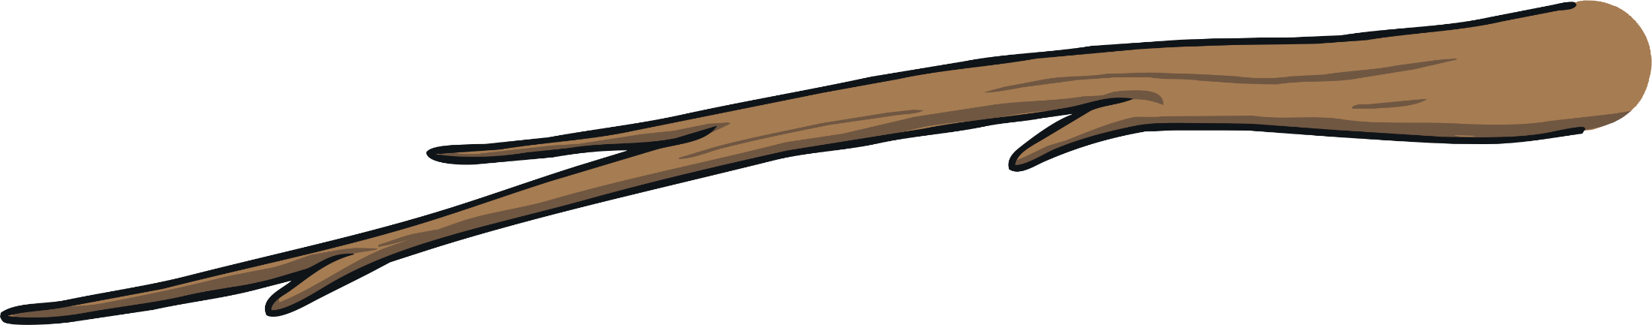
Teach
gnaw
sign
gnome
gnash
gnarl
design
gnat

Slide 13
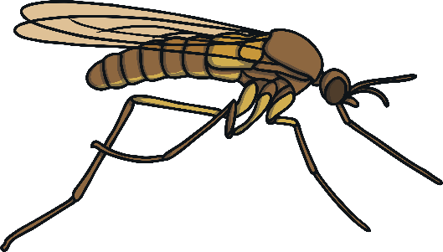


A Cloud of Gnats
Practise
As Kit and Sam are pruning the shrubs, they see a cloud of gnats flying around. Can you match the gnats to the words?

Slide 14

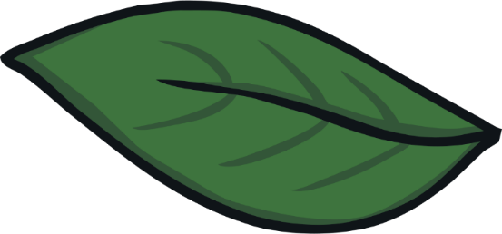
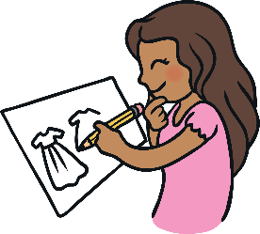
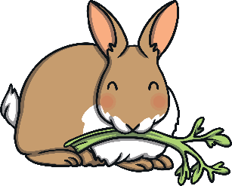
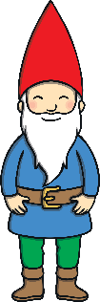
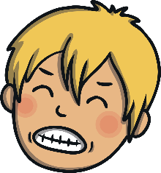

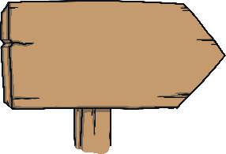
Practise
gnome
sign
gnaw
gnash
design
HOME

Slide 15

Practise
gnome
sign
gnaw
gnash
design

Slide 16

Practise
gnome
sign
gnaw
gnash
design

Slide 17

Practise
gnome
sign
gnaw
gnash
design

Slide 18
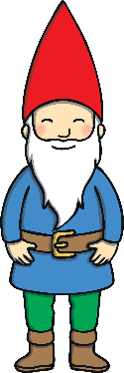
Practise
gnome
sign
gnaw
gnash
design

Slide 19
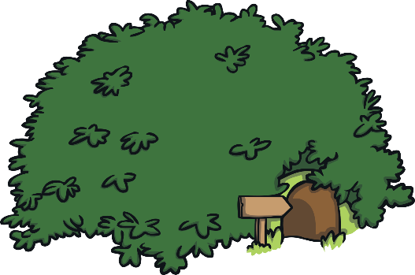
Apply
“Shoo,” said Kit as he wafted the gnats away. As Kit and Sam carefully pruned the shrub, they uncovered a tunnel in the earth. “Look!” said Kit, “There’s a little sign outside.”

Slide 20
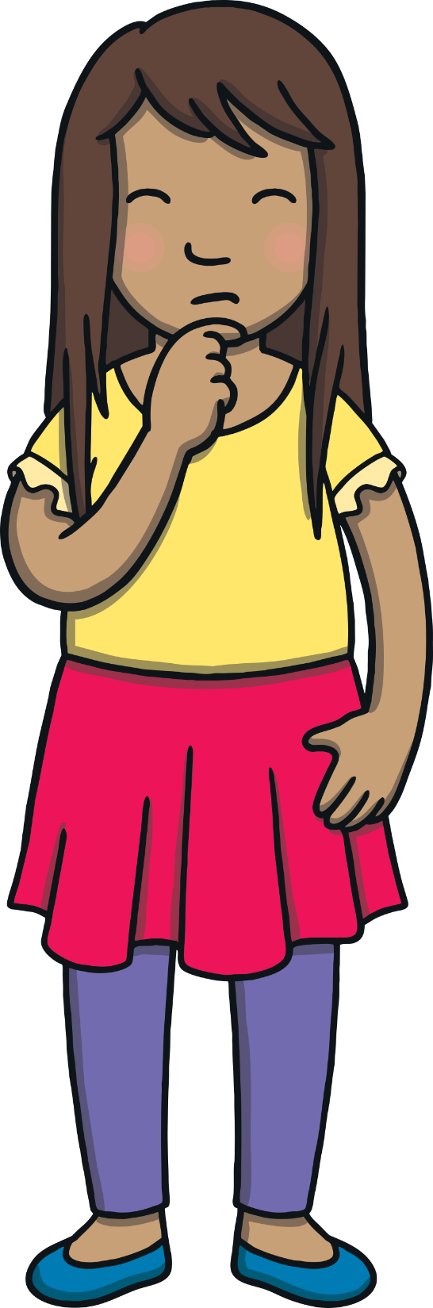
Text Detectives!
Apply
There is a sign outside the tunnel.
Can you read it and spot any words containing gn?

Slide 21

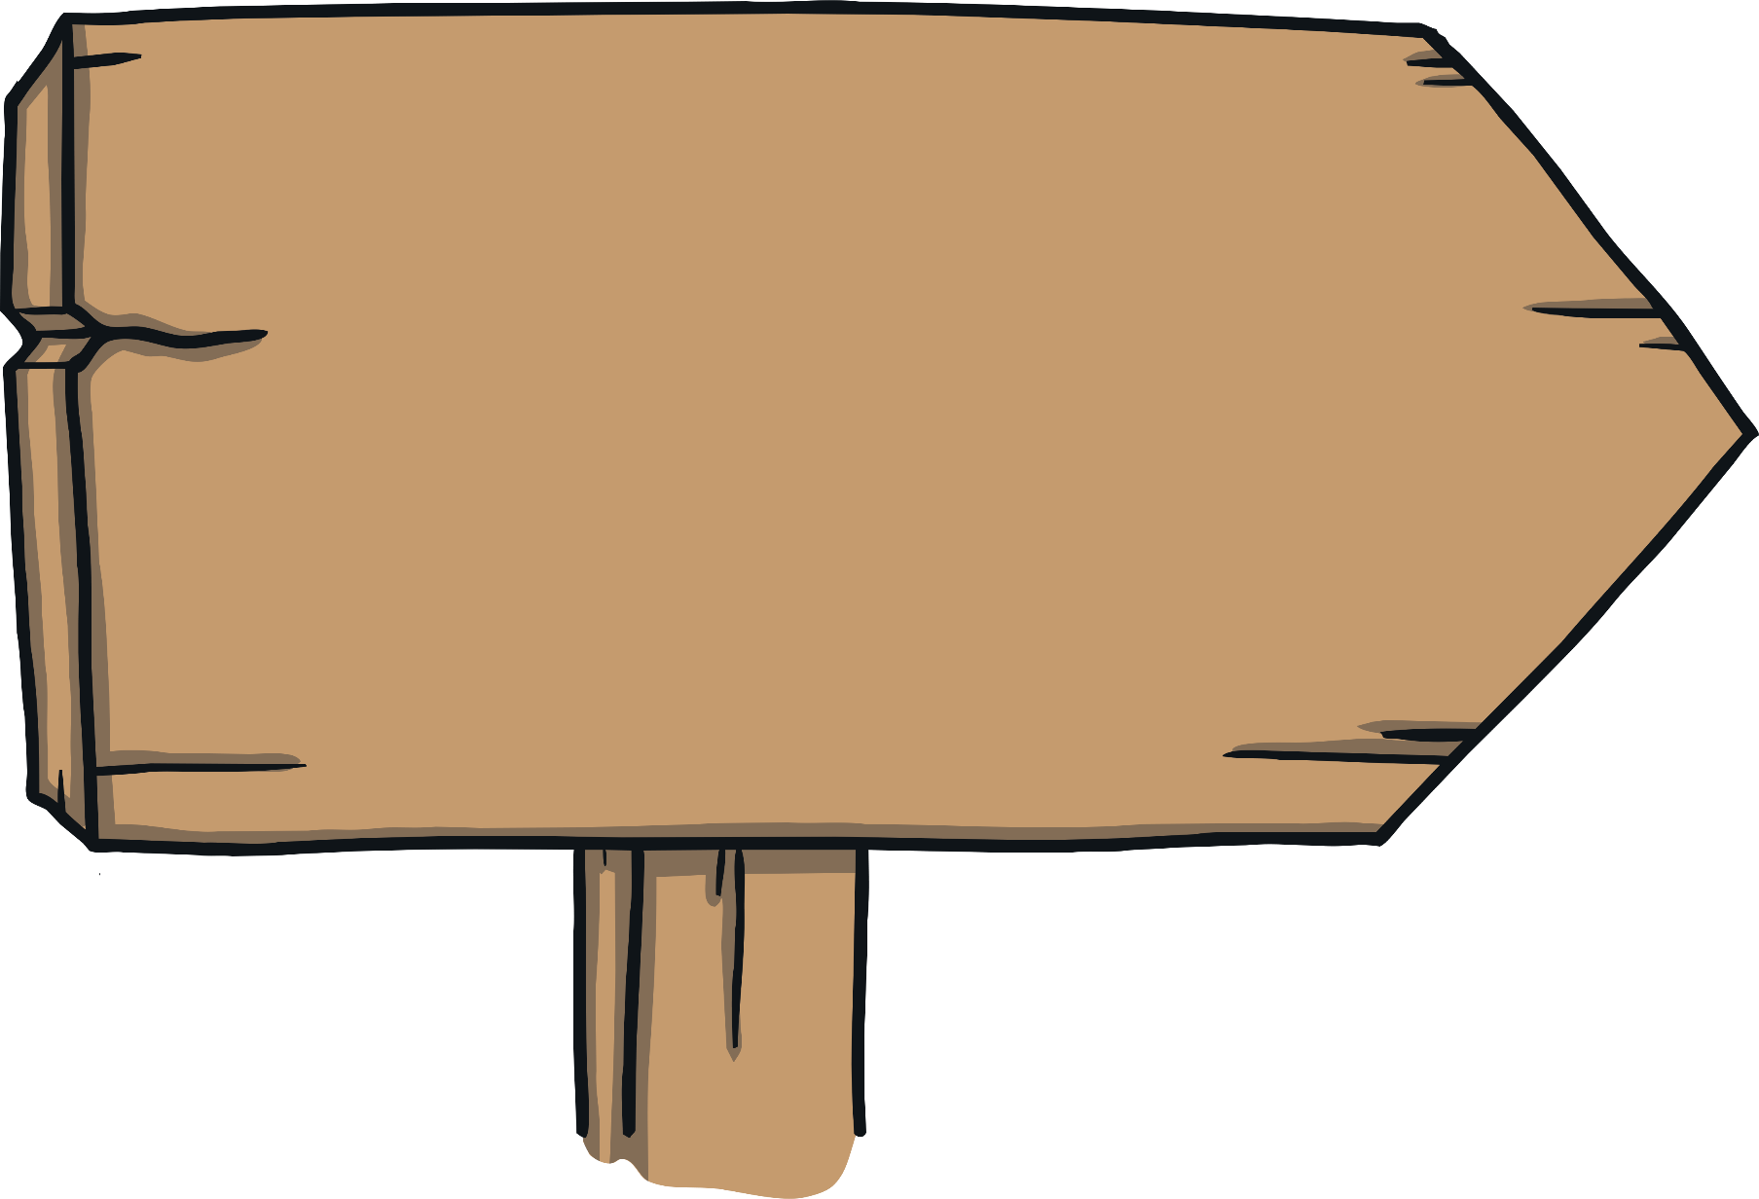
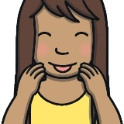
Apply
Gnome’s Home Sign
To find the gnome’s home
Turn left after the gnarl.
Turn right at the gnawed wood,
Gnats not allowed!
Gnome’s Home Sign
To find the gnome’s home
Turn left after the gnarl.
Turn right at the gnawed wood,
Gnats not allowed!
Check

Slide 22

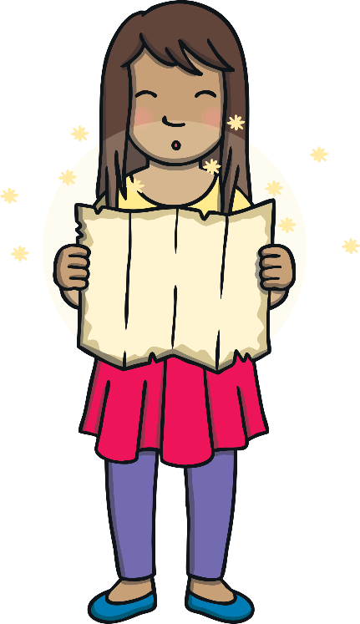
Apply
“I would love to visit the gnome!” said Kit, putting down his pruning shears.
“Me too!” said Sam. “Are you thinking what I’m thinking?” she said as she took the magic map out of her pocket.

Slide 23
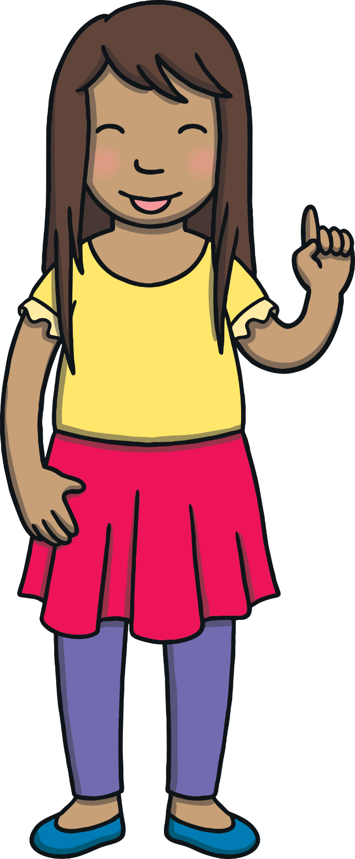
Today, we have learnt…
gn
saying /n/
The adventure continues next lesson!

