Slide 1
An Anglo Saxon Time-line
Without dates

Slide 2
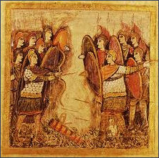
1. Battle of Mount Badon
The Anglo Saxons were defeated at Mount Badon, by an army led by a Roman Briton, possibly called Arthur.
1. Early Anglo Saxon Britain
(410 to 560 AD)
2. Religious Rule – the Christian Missions (561AD to 750AD)
3. Anglo Saxon versus Anglo Saxon (751AD to 860AD)
An image showing the Britons led by King Arthur arrayed against the Anglo Saxons
4. Anglo Saxon versus Viking
(861AD to 1066AD)

Slide 3
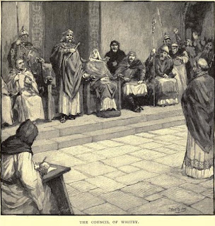
2. Celts versus Romans
In Britain, there was a split was between the Celtic Church and the Catholic Church.
1. Early Anglo Saxon Britain
(410 to 560 AD)
2. Religious Rule – the Christian Missions (561AD to 750AD)
3. Anglo Saxon versus Anglo Saxon (751AD to 860AD)
4. Anglo Saxon versus Viking
(861AD to 1066AD)

Slide 4
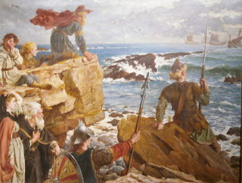
3. First Viking attack
The first Viking attack in Britain was in Dorset.
1. Early Anglo Saxon Britain
(410 to 560 AD)
2. Religious Rule – the Christian Missions (561AD to 750AD)
3. Anglo Saxon versus Anglo Saxon (751AD to 860AD)
How the Danes Came Up the Channel a Thousand Years Ago,
Herbert A Bone (Russell-Cotes Museum)
4. Anglo Saxon versus Viking
(861AD to 1066AD)

Slide 5
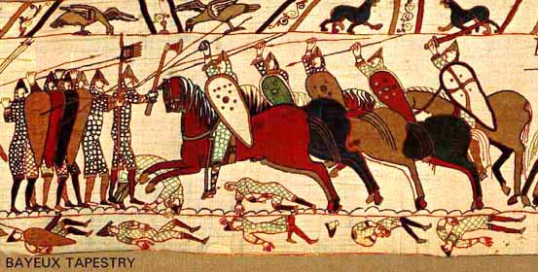
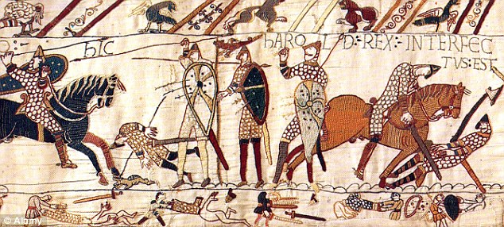
4. Battle of Hastings
When Edward the Confessor died without a son, there were three men with claims to be King. William eventually won.
1. Early Anglo Saxon Britain
(410 to 560 AD)
2. Religious Rule – the Christian Missions (561AD to 750AD)
3. Anglo Saxon versus Anglo Saxon (751AD to 860AD)
4. Anglo Saxon versus Viking
(861AD to 1066AD)

Slide 6
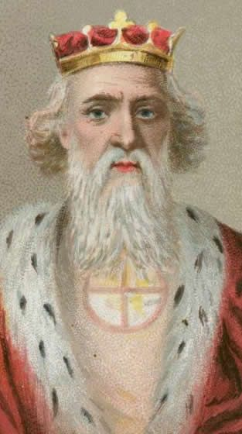
5. The last Anglo Saxon King
Harold Goodwinson, who was crowned Edward the confessor’s successor was the last Anglo Saxon King of England.
1. Early Anglo Saxon Britain
(410 to 560 AD)
2. Religious Rule – the Christian Missions (561AD to 750AD)
3. Anglo Saxon versus Anglo Saxon (751AD to 860AD)
4. Anglo Saxon versus Viking
(861AD to 1066AD)

Slide 7
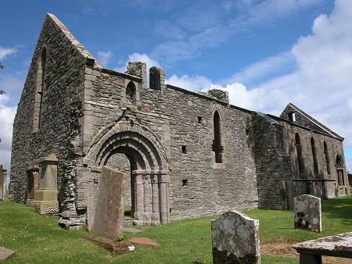
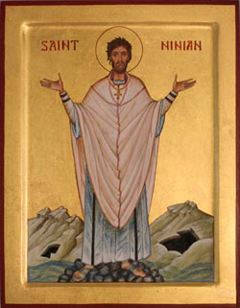
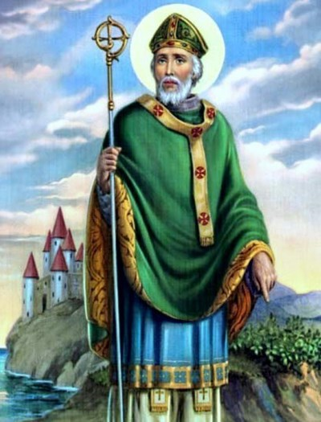
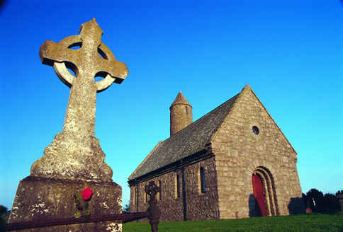
6. Missions to the British Isles
Soon after the end of Romans in Britain, Christian missionaries appeared.
1. Early Anglo Saxon Britain
(410 to 560 AD)
2. Religious Rule – the Christian Missions (561AD to 750AD)
3. Anglo Saxon versus Anglo Saxon (751AD to 860AD)
4. Anglo Saxon versus Viking
(861AD to 1066AD)

Slide 8
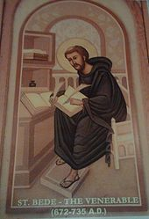
7. The Venerable Bede
St Bede was responsible for writing the first true history of England.
1. Early Anglo Saxon Britain
(410 to 560 AD)
2. Religious Rule – the Christian Missions (561AD to 750AD)
3. Anglo Saxon versus Anglo Saxon (751AD to 860AD)
4. Anglo Saxon versus Viking
(861AD to 1066AD)

Slide 9
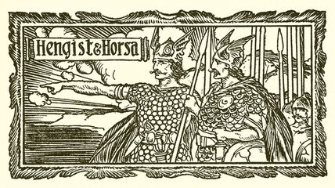
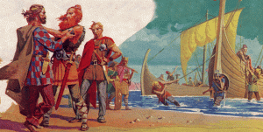
8. Horsa and Hengest
With no armies of his own, the King of Britain sought the help of the Anglo Saxon mercenaries.
1. Early Anglo Saxon Britain
(410 to 560 AD)
2. Religious Rule – the Christian Missions (561AD to 750AD)
3. Anglo Saxon versus Anglo Saxon (751AD to 860AD)
4. Anglo Saxon versus Viking
(861AD to 1066AD)

Slide 10
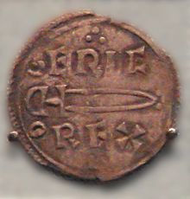
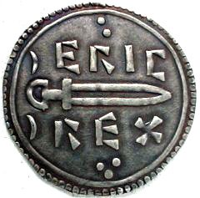

9. An Anglo Saxon England
When Erik Bloodaxe was driven from York, by his fellow Vikings, an Anglo Saxon king ruled the whole of England.
1. Early Anglo Saxon Britain
(410 to 560 AD)
A coin and its replica minted in York during Eric’s reign
2. Religious Rule – the Christian Missions (561AD to 750AD)
3. Anglo Saxon versus Anglo Saxon (751AD to 860AD)
4. Anglo Saxon versus Viking
(861AD to 1066AD)
Reconstruction painting of the wooden houses of the Viking-Age city of Jorvik, © York Archaeological Trust

Slide 11
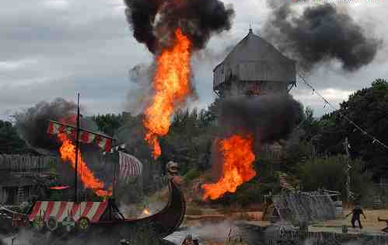
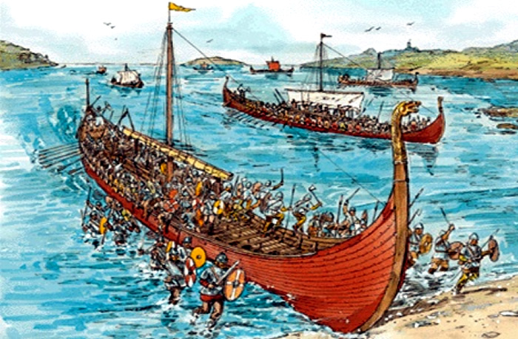
10. Viking Victories
Landing a great army, in Northumbria, the Vikings quickly seized York and marched south.
1. Early Anglo Saxon Britain
(410 to 560 AD)
2. Religious Rule – the Christian Missions (561AD to 750AD)
3. Anglo Saxon versus Anglo Saxon (751AD to 860AD)
4. Anglo Saxon versus Viking
(861AD to 1066AD)

Slide 12
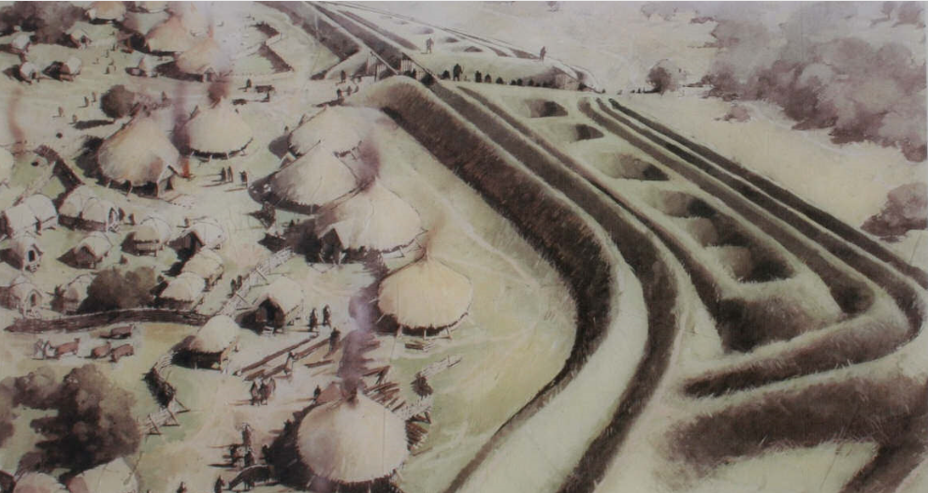
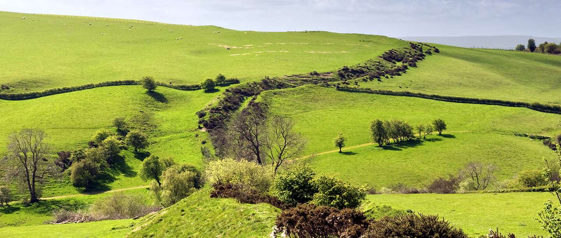
11. Offa’s Dyke
Offa, King of Mercia, built a great earthwork dyke to keep his kingdom safe from the Welsh.
1. Early Anglo Saxon Britain
(410 to 560 AD)
2. Religious Rule – the Christian Missions (561AD to 750AD)
How Offa’s Dyke might have looked
3. Anglo Saxon versus Anglo Saxon (751AD to 860AD)
4. Anglo Saxon versus Viking
(861AD to 1066AD)
How Offa’s Dyke looks today.

Slide 13
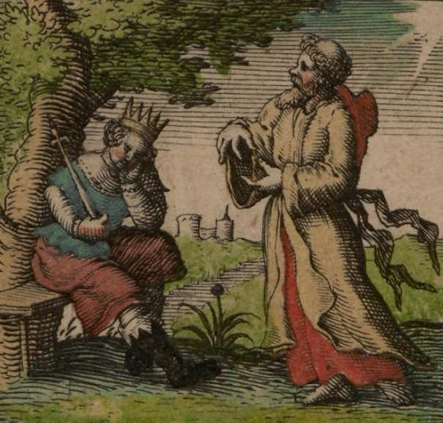
12. Christian King in the North
After marrying the princess of Kent, Edwin became the second Christian King in England.
1. Early Anglo Saxon Britain
(410 to 560 AD)
2. Religious Rule – the Christian Missions (561AD to 750AD)
3. Anglo Saxon versus Anglo Saxon (751AD to 860AD)
Edwin’s conversion to Christianity John Speed - John Speed's Saxon Heptarchy 1611
4. Anglo Saxon versus Viking
(861AD to 1066AD)

Slide 14
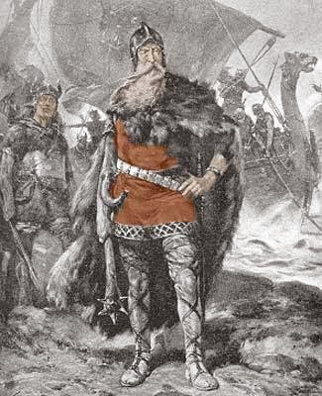
13. A Viking King
When Aethelred the Unready was defeated by Swein Forkbeard, it wasn’t long before Cnut, Swein’s son, was crowned king of England.
1. Early Anglo Saxon Britain
(410 to 560 AD)
2. Religious Rule – the Christian Missions (561AD to 750AD)
3. Anglo Saxon versus Anglo Saxon (751AD to 860AD)
4. Anglo Saxon versus Viking
(861AD to 1066AD)
An artist impression of Swein Forkbeard

Slide 15
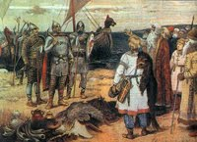
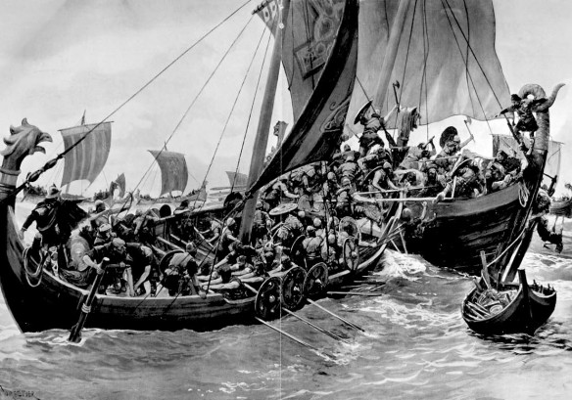
14. Vikings defeat
Athelstan, son of Edwin, defeated a Viking fleet off the coast of Kent.
1. Early Anglo Saxon Britain
(410 to 560 AD)
2. Religious Rule – the Christian Missions (561AD to 750AD)
Viking raiders accepting defeat
3. Anglo Saxon versus Anglo Saxon (751AD to 860AD)
4. Anglo Saxon versus Viking
(861AD to 1066AD)
Reconstruction of the battle

Slide 16
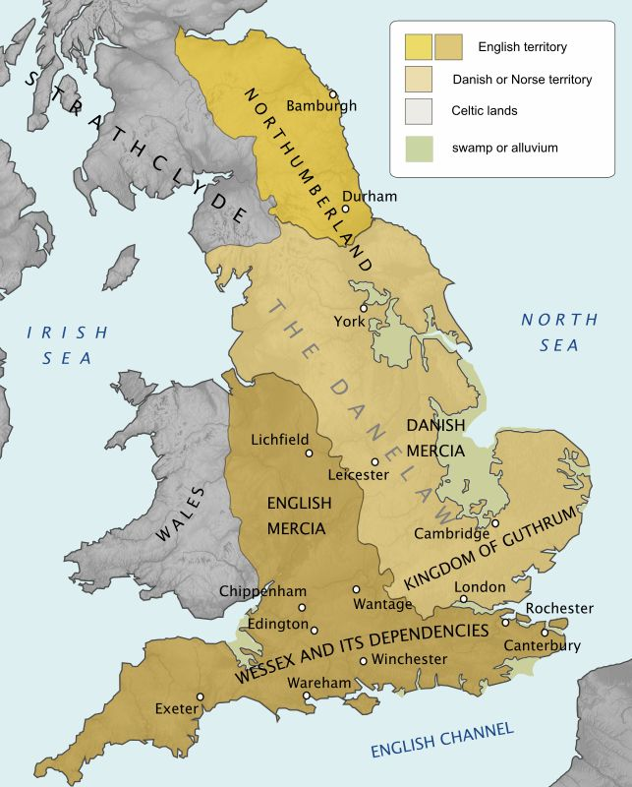
15. Alfred the Great, Danelaw and Athelstan
Alfred did not give up. Rallying men loyal to his crown, he defeated the Vikings at the Battle of Edington.
1. Early Anglo Saxon Britain
(410 to 560 AD)
2. Religious Rule – the Christian Missions (561AD to 750AD)
3. Anglo Saxon versus Anglo Saxon (751AD to 860AD)
4. Anglo Saxon versus Viking
(861AD to 1066AD)

Slide 17
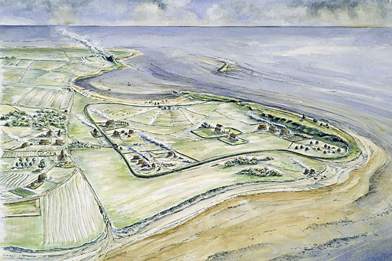
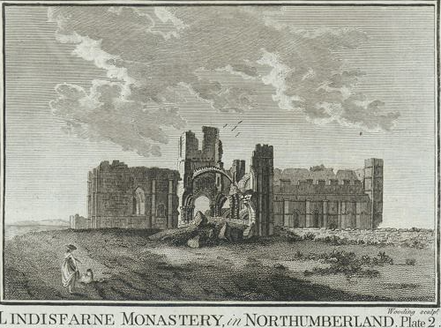
16. The first monasteries
St Aidan built the monastery of Lindisfarne, where missionaries were trained to help convert the Anglo Saxons.
1. Early Anglo Saxon Britain
(410 to 560 AD)
An artist’s impression of the 7th-century monastery at Lindisfarne
© Historic England (illustration by Peter Dunn)
2. Religious Rule – the Christian Missions (561AD to 750AD)
3. Anglo Saxon versus Anglo Saxon (751AD to 860AD)
4. Anglo Saxon versus Viking
(861AD to 1066AD)

Slide 18
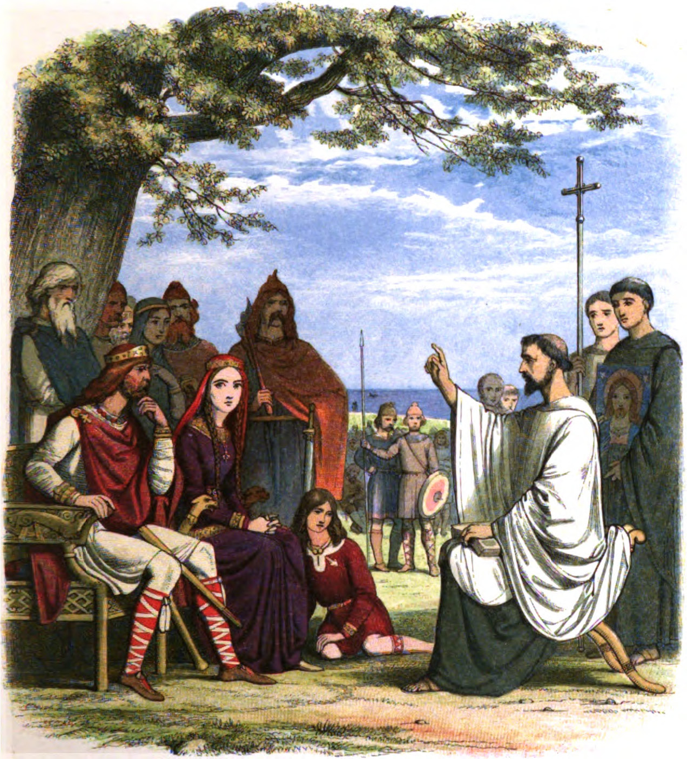
17. Conversion to Christianity
The Anglo Saxons had their own gods. However, missionaries soon started to convert them to Christianity.
1. Early Anglo Saxon Britain
(410 to 560 AD)
2. Religious Rule – the Christian Missions (561AD to 750AD)
3. Anglo Saxon versus Anglo Saxon (751AD to 860AD)
4. Anglo Saxon versus Viking
(861AD to 1066AD)
An image of St Augustine converting King Ethelbert of Kent to Christianity

Slide 19
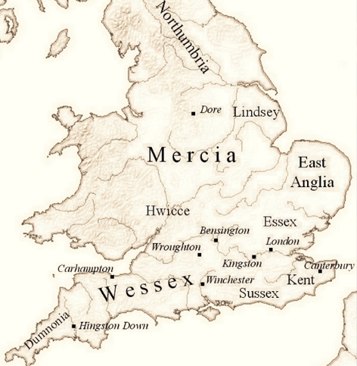
18. Conquest of Mercia
Egbert, king of the West Saxons, attacked Mercia, and became the undisputed King of the South.
1. Early Anglo Saxon Britain
(410 to 560 AD)
2. Religious Rule – the Christian Missions (561AD to 750AD)
3. Anglo Saxon versus Anglo Saxon (751AD to 860AD)
4. Anglo Saxon versus Viking
(861AD to 1066AD)
The Saxon Kingdoms before 829AD

Slide 20
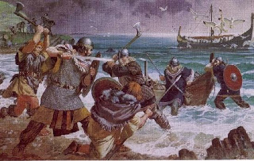
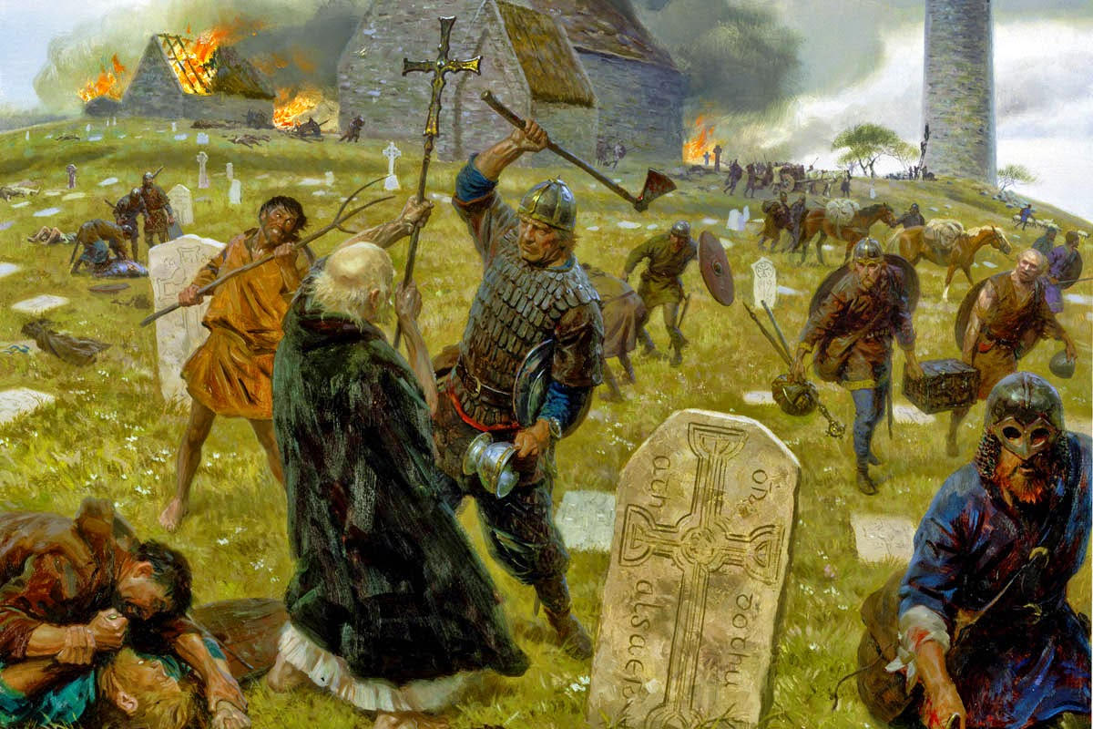
19. Viking sacking of Lindisfarne Monastery
The Vikings raided monasteries and churches along the coast seizing gold and silver, and Anglo Saxons to be slaves, for 70 years.
1. Early Anglo Saxon Britain
(410 to 560 AD)
Viking raiders sacking Lindisfarne
2. Religious Rule – the Christian Missions (561AD to 750AD)
3. Anglo Saxon versus Anglo Saxon (751AD to 860AD)
4. Anglo Saxon versus Viking
(861AD to 1066AD)

Slide 21
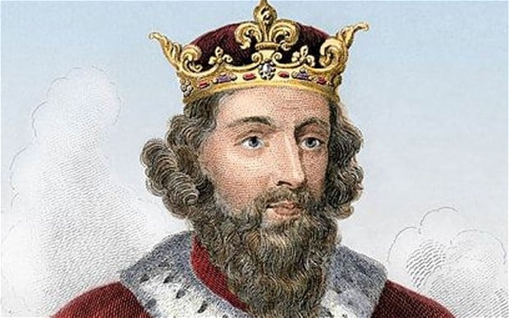
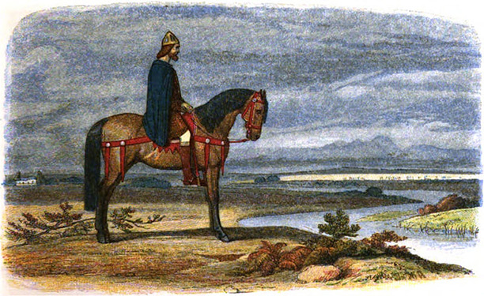
20. A king in hiding
Beset on all sides Viking armies overran Wessex, forcing Alfred to hide in marshes of Athelney, in Somerset.
1. Early Anglo Saxon Britain
(410 to 560 AD)
2. Religious Rule – the Christian Missions (561AD to 750AD)
3. Anglo Saxon versus Anglo Saxon (751AD to 860AD)
4. Anglo Saxon versus Viking
(861AD to 1066AD)

Slide 22

21. An Anglo Saxon epic – Beowulf
The story of Beowulf’s battle against the monster Grendel, its mother, and a number of dragons is recognised as the first piece of English literature.
.
1. Early Anglo Saxon Britain
(410 to 560 AD)
2. Religious Rule – the Christian Missions (561AD to 750AD)
3. Anglo Saxon versus Anglo Saxon (751AD to 860AD)
4. Anglo Saxon versus Viking
(861AD to 1066AD)

Slide 23
Well Done!
Question I
Question II
Question III
Question IV
Question V
Question VI
Question VII
Question VIII
Question IX
Question X
Question XI
Question XII
Question XIII
Question XIV
Question XV
Question XVI
Question XVII
Question XVIII
Question XIX
Question XX
Question XXI

Slide 24
Try again

