Slide 1
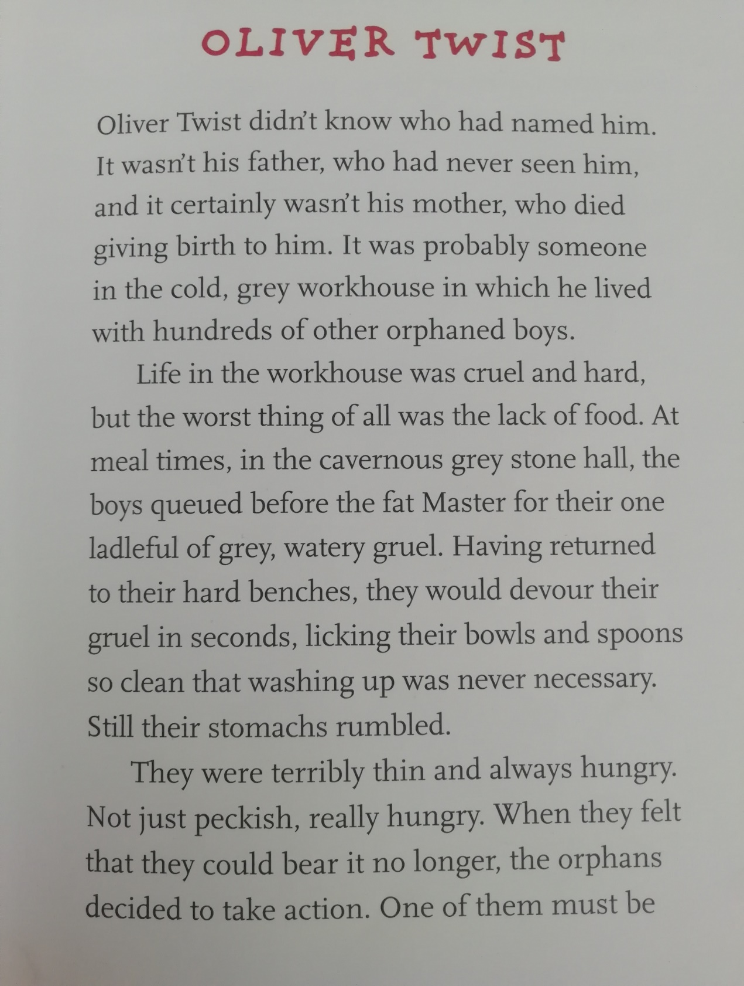

Slide 2
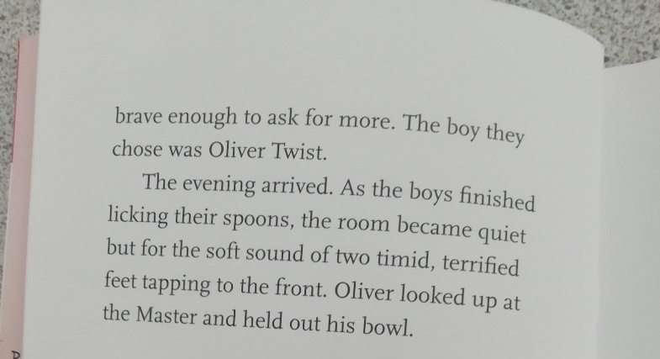

Slide 3
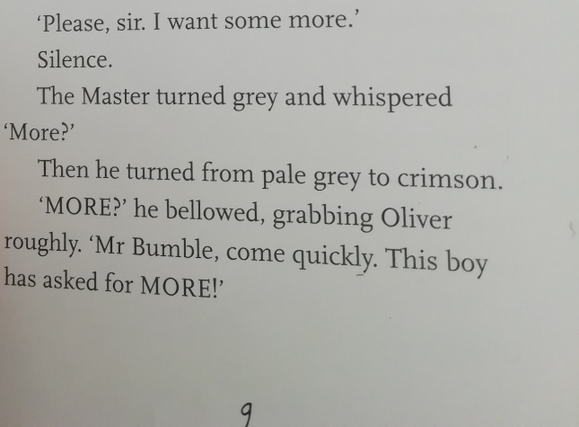

Slide 4
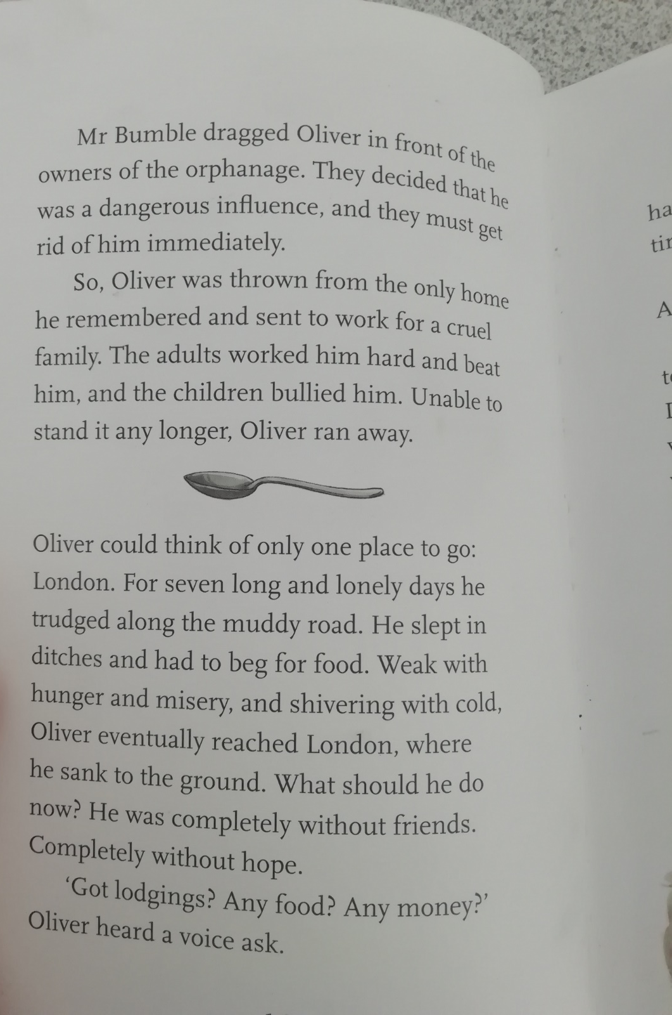

Slide 5
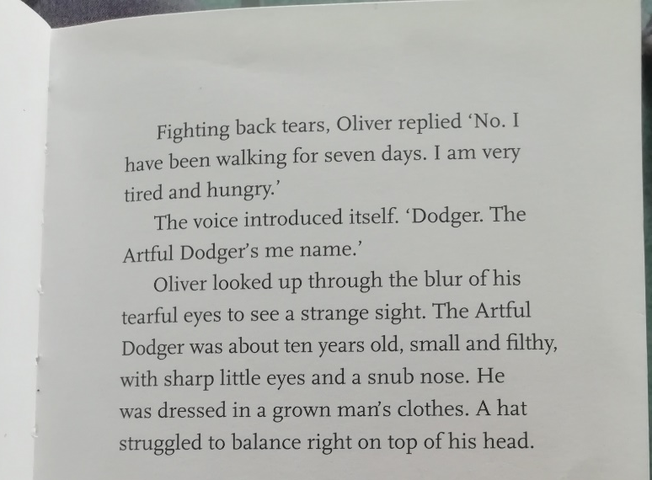

Slide 6
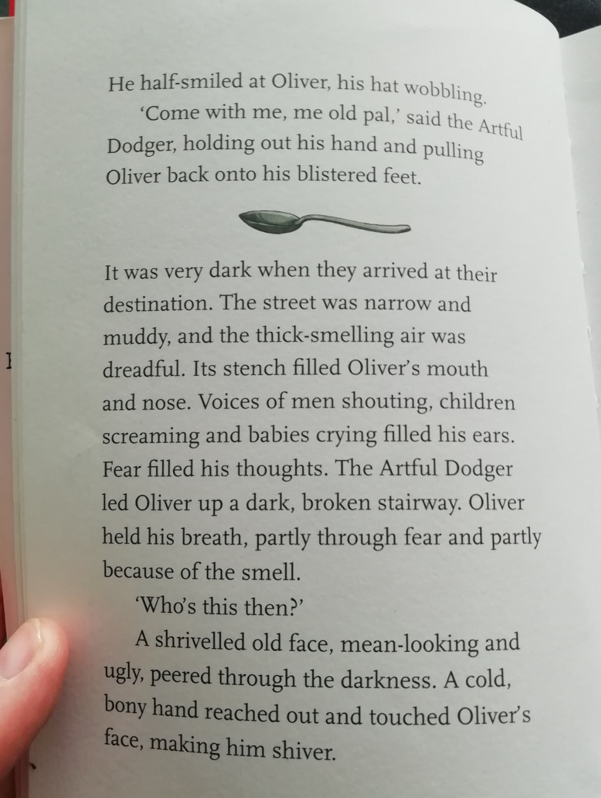

Slide 7
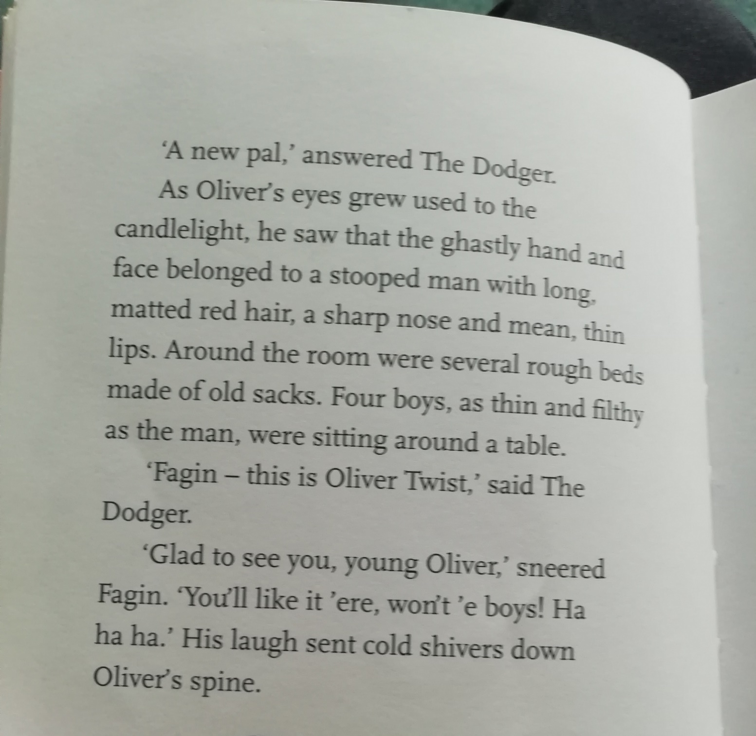

Slide 8
What phrases can we find that suggest Fagin isn’t a nice person?
What do we think are Oliver’s prospects like? (Does he look like he is going to live a long happy life?)
Why do you think Charles Dickens wrote a story about work houses?
Can you write a prediction about what you think will happen later in the story?
Fact for you (5d is equal to 5pence) some children we paid £1.71 a week in today’s money for a weeks worth of work.

